Slide 1
Games
UT Dallas CS6301 Special Topics in Computer Science – Convolutional Neural Networks
Arthur J. Redfern arthur.redfern@utdallas.edu Apr 24, 2019 Apr 29, 2019

Slide 2

UT Dallas CS6301 Special Topics in Computer Science – Convolutional Neural Networks
Greetings, Professor Falken.
Hello, Joshua.
A strange game. The only winning move is not to play. How about a nice game of chess?
– War Games (1983)
Figure from http://mentalfloss.com/article/545667/facts-about-wargames

Slide 3
Outline
UT Dallas CS6301 Special Topics in Computer Science – Convolutional Neural Networks
Motivation
Reinforcement learning
Decision making
Value based
Policy based
Model based
Appendix
References

Slide 4
Motivation
UT Dallas CS6301 Special Topics in Computer Science – Convolutional Neural Networks

Slide 5
Why Play Games?
UT Dallas CS6301 Special Topics in Computer Science – Convolutional Neural Networks
Playing games requires making decisions
Vision, speech and language were about extracting information from data
But then what? What do you do with the information you extracted?
Frequently you want to make a decision based on it and take some action
So we’ll look at how to make decisions in the context of games
Realize, though, that it’s not a big jump to take the methods used for making decisions in games and apply them to controls, robotics, autonomous vehicles, ...
However, it’s more fun to start with games so we’ll start with games and a question
How do you learn to make decisions?
Imitating someone who’s good at making decisions
Passively observing the environment to learn what rewards different actions lead to
Interacting with the environment to learn what rewards different actions lead to

Slide 6
Reinforcement Learning
UT Dallas CS6301 Special Topics in Computer Science – Convolutional Neural Networks

Slide 7
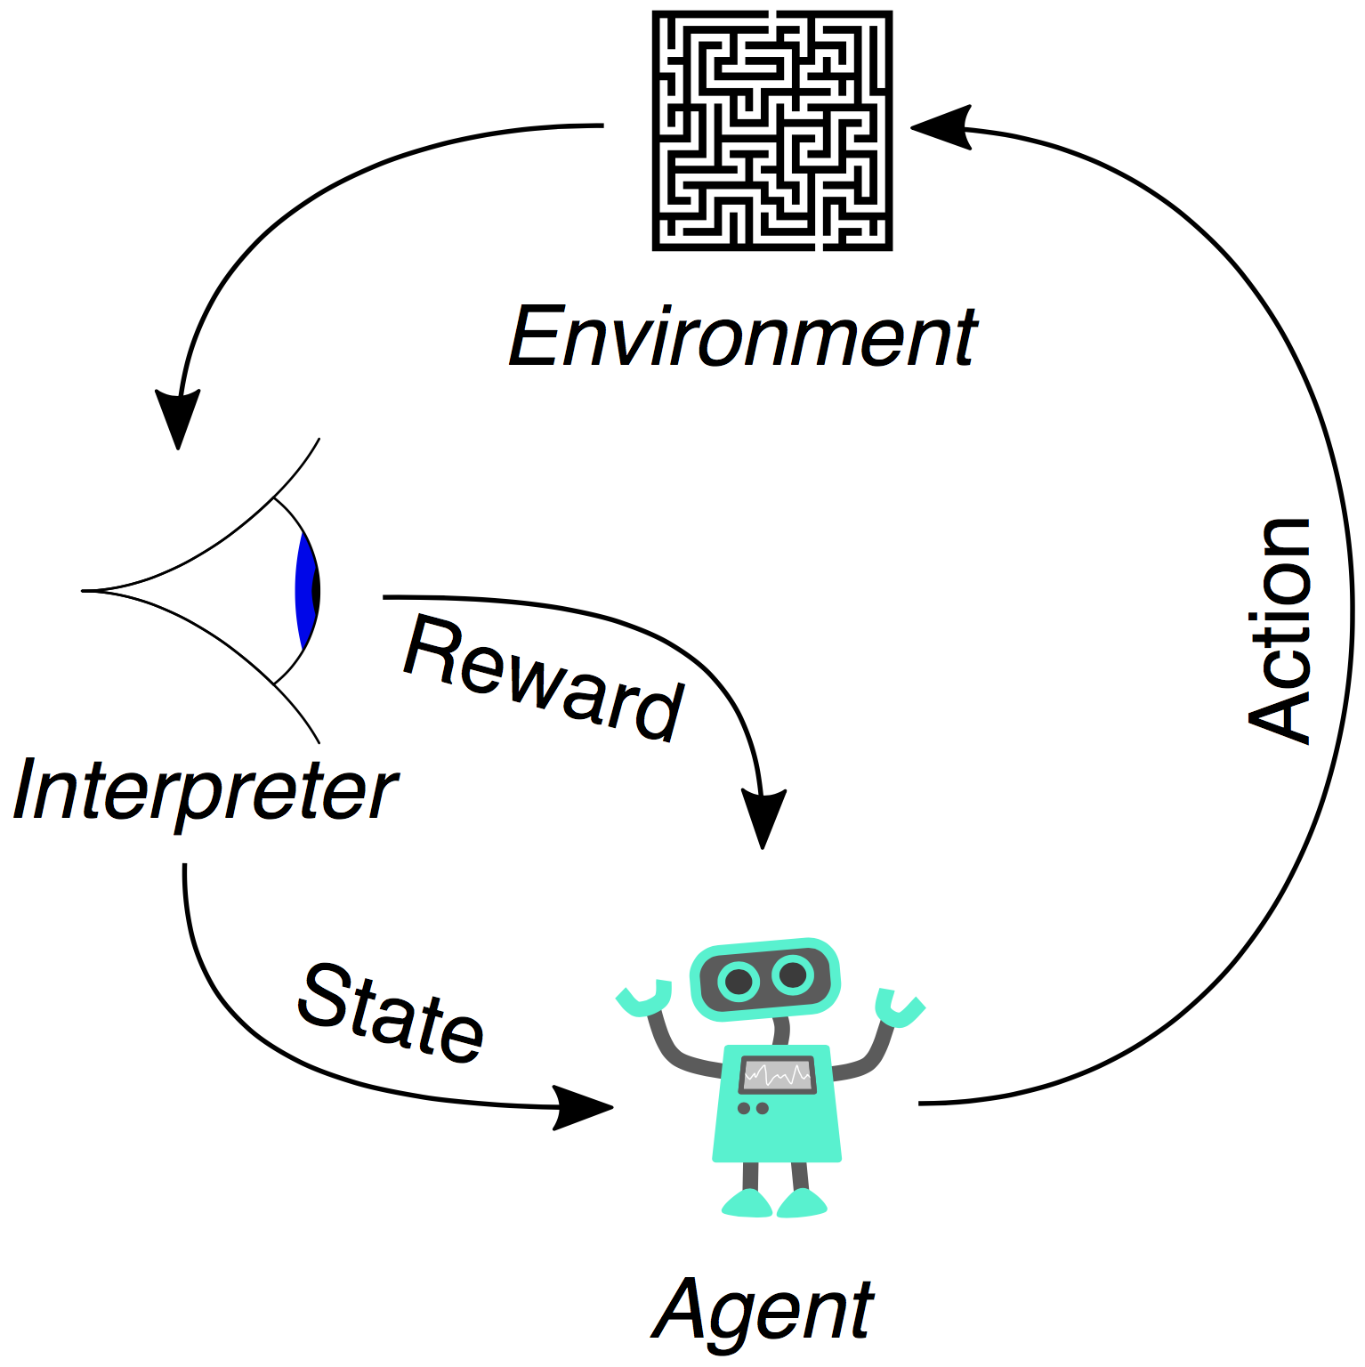
Agents And Environments
UT Dallas CS6301 Special Topics in Computer Science – Convolutional Neural Networks
Figure from https://en.wikipedia.org/wiki/Reinforcement_learning

Slide 8
Markov Decision Processes
UT Dallas CS6301 Special Topics in Computer Science – Convolutional Neural Networks
A mathematical description of the previous page
S is the set of all valid states
s_{t} is the state at time t
The state is a complete description of the fully or partially observable environment
A is the set of all valid actions
a_{t} is the action at time t
Actions are decisions and can be discrete or continuous, state independent or dependent
R: S x A → ℝ is the reward function that maps states and actions to a reward
r_{t} is the reward at time t
In a stochastic setting R is a random variable with pmf p_{R}(r_{t} | s_{t}, a_{t}) such that r_{t} ~ R(s_{t}, a_{t})
P: S x A → S is the state transition function that maps states and actions to new states
In a stochastic setting P is a random variable with pmf p_{P}(s_{t+1} | s_{t}, a_{t}) such that s_{t+1} ~ P(s_{t}, a_{t})
μ: → S is the initial state function that returns the initial state
In a stochastic setting μ is a random variable with pmf p_{μ}(s₀) such that s₀ ~ μ

Slide 9
Policies
UT Dallas CS6301 Special Topics in Computer Science – Convolutional Neural Networks
π: S → A is a policy function used by the agent to take actions
A policy tells an agent how to act: when in state s_{t} take action a_{t}
Deterministic policy a_{t} = π(s_{t})
Stochastic policy a_{t} ~ π(s_{t}) with pmf p_{π}(a_{t} | s_{t})
A function with parameters θ is frequently used for the policy
Stochastic policy a_{t} ~ π_{θ}(s_{t}) with pmf p_{π_θ}(a_{t} | s_{t})
These slides will typically use xNNs for policy functions
Universal function approximators
Learning a policy requires training a network

Slide 10
Policies
UT Dallas CS6301 Special Topics in Computer Science – Convolutional Neural Networks
Categorical policies are used for discrete action spaces
Ex: xNN + softmax maps a state to a vector representing a pmf of actions
Elements in the vector represent the probability of the corresponding action
Actions are sampled based on the pmf
Log likelihoods are frequently needed
log p_{π}(a_{t} | s_{t})
Diagonal Gaussian policies are (commonly) used for continuous action spaces
Ex: xNN maps a state to a vector representing mean actions
μ_{π}(s_{t}) = E[π(s_{t})]
Have a separate vector representing the std dev of actions σ_{π}(s_{t})
σ_{π}(s_{t}) is maybe fixed, maybe from a network
Let z_{t} ~ N(0, I)
Actions are sampled a_{t} ~ μ_{π}(s_{t}) + σ_{π}(s_{t}) ⊙ z_{t}
Log likelihoods are frequently needed
log p_{π}(a_{t} | s_{t}) = – 0.5(Σ_{i=0:k-1}((a_{i} – μ_{i})²/σ_{i}² + 2 logσ_{i}) + k log2π)

Slide 11
Trajectories
UT Dallas CS6301 Special Topics in Computer Science – Convolutional Neural Networks
A trajectory τ is a sequence of states, actions and rewards
τ = (s₀, a₀, r₀, s₁, a₁, r₁, s₂, a₂, r₂, ...)
The probability and generation of a trajectory given a policy π
Pr(τ | a ~ π) = p_{μ}(s₀) ∏_{t=0:T-1} p_{P}(s_{t+1} | s_{t}, a_{t}) p_{π}(a_{t} | s_{t})
Initialize s₀ ~ μ and t = 0
Loop
a_{t} ~ π(s_{t})
r_{t} ~ R(s_{t}, a_{t})
s_{t+1} ~ P(s_{t}, a_{t})
t ← t + 1
Notation
τ ~ π will be used to denote that the trajectory is created as above unless otherwise specified (i.e., a part of the default is explicitly overwritten)

Slide 12
Total Rewards
UT Dallas CS6301 Special Topics in Computer Science – Convolutional Neural Networks
Finite horizon undiscounted total reward
R_{t:T-1}(τ) = Σ_{i=t:T-1} r_{i}
Infinite horizon discounted total reward
R_{t:∞}(τ, ɣ) = Σ_{i=t:∞} ɣ^{i-t} r_{i} , ɣ ∈ (0, 1)
Allows convergence
Favors sooner rewards more than later rewards
Finite horizon discounted total reward
R_{t:T-1}(τ, ɣ) = Σ_{i=t:T-1} ɣ^{i-t} r_{i} , ɣ ∈ (0, 1)
Favors sooner rewards more than later rewards
Frequently used in practice
Notation
R_{t:}(τ) will be used to generically indicate the total reward starting at time t and continuing to the end

Slide 13
The Goal Of Reinforcement Learning
UT Dallas CS6301 Special Topics in Computer Science – Convolutional Neural Networks
Choose a policy π that maximizes the expected total reward R_{t:}(τ)
Expected total reward
J(π) = ∫_{τ} Pr(τ | a ~ π) R_{t:}(τ) = E[R_{t:}(τ) | τ ~ π]
The optimal policy is the policy that maximizes the expected total reward
π* = arg max_{π} J(π)
The policy tells the agent how to act
So knowing the optimal policy allows the agent to maximize the expected total reward

Slide 14
Value Function
UT Dallas CS6301 Special Topics in Computer Science – Convolutional Neural Networks
The value function returns the expected total reward if
In state s_{t} and
Actions are chosen according to policy π for t onward
V^{π}(s_{t}) = E[R_{t:}(τ) | s_{t}, τ ~ π for t onward]
The optimal value is the maximum expected total reward
V*(s_{t}) = max_{π} V^{π}(s_{t}) = max_{a_t} Q*(s_{t}, a_{t})
The value function tells you how good a state is for a given policy
These slides will typically use xNNs for value functions

Slide 15
Action Value Function (Q Function)
UT Dallas CS6301 Special Topics in Computer Science – Convolutional Neural Networks
The action value function (Q function) returns the expected total reward if
In state s_{t} and
Action a_{t} is taken and
Subsequent actions are chosen according to policy π for t + 1 onward
Q^{π}(s_{t}, a_{t}) = E[R_{t:}(τ) | s_{t}, a_{t}, τ ~ π for t+1 onward]
The optimal action value (optimal Q value) is the maximum expected total reward after taking action a_{t} in state s_{t}
Q*(s_{t}, a_{t}) = max_{π} Q^{π}(s_{t}, a_{t})
a_{t}* = arg max_{a_t} Q*(s_{t}, a_{t})
Knowing Q*(s_{t}, a_{t}) allows the selection of the optimal action a_{t} for a given state s_{t}
These slides will typically use xNNs for action value functions

Slide 16
Bellman Equation
UT Dallas CS6301 Special Topics in Computer Science – Convolutional Neural Networks
Value and action value functions satisfy the Bellman equation
This property will be exploited in a fixed point framework for iterative estimation
Note the max in the optimal value and action value functions, this will implicitly increase the value in that fixed point equation via looking ahead 1 action (later methods that integrate tree search will improve on this basic strategy)
Values
V^{π}(s_{t}) = E[R(s_{t}, a_{t}) + ɣ V^{π}(s_{t+1}) | s_{t}, τ ~ π for t onward]
V*(s_{t}) = max_{a_t} E[R(s_{t}, a_{t}) + ɣ V*(s_{t+1}) | s_{t}, τ ~ π* for t+1 onward]
Action values
Q^{π}(s_{t} ,a_{t}) = E[R(s_{t}, a_{t}) + ɣ Q^{π}(s_{t+1}, a_{t+1}) | s_{t}, a_{t}, τ ~ π for t+1 onward]
Q*(s_{t} ,a_{t}) = E[R(s_{t}, a_{t}) + ɣ max_{a_t+1}Q*(s_{t+1}, a_{t+1}) | s_{t}, a_{t}, τ ~ π* for t+2 onward]

Slide 17
Advantage Function
UT Dallas CS6301 Special Topics in Computer Science – Convolutional Neural Networks
A^{π}(s_{t} ,a_{t}) = Q^{π}(s_{t} ,a_{t}) – V^{π}(s_{t})
Interpretation
Used to specify how much better it is to take action a_{t} in s_{t} instead of a_{t} ~ π(s_{t})
Assumes a_{i} ~ π(s_{i}) for all i ≥ t + 1
Positive advantage means that the chosen action was better than what was expected from the policy

Slide 18
Decision Making
UT Dallas CS6301 Special Topics in Computer Science – Convolutional Neural Networks

Slide 19
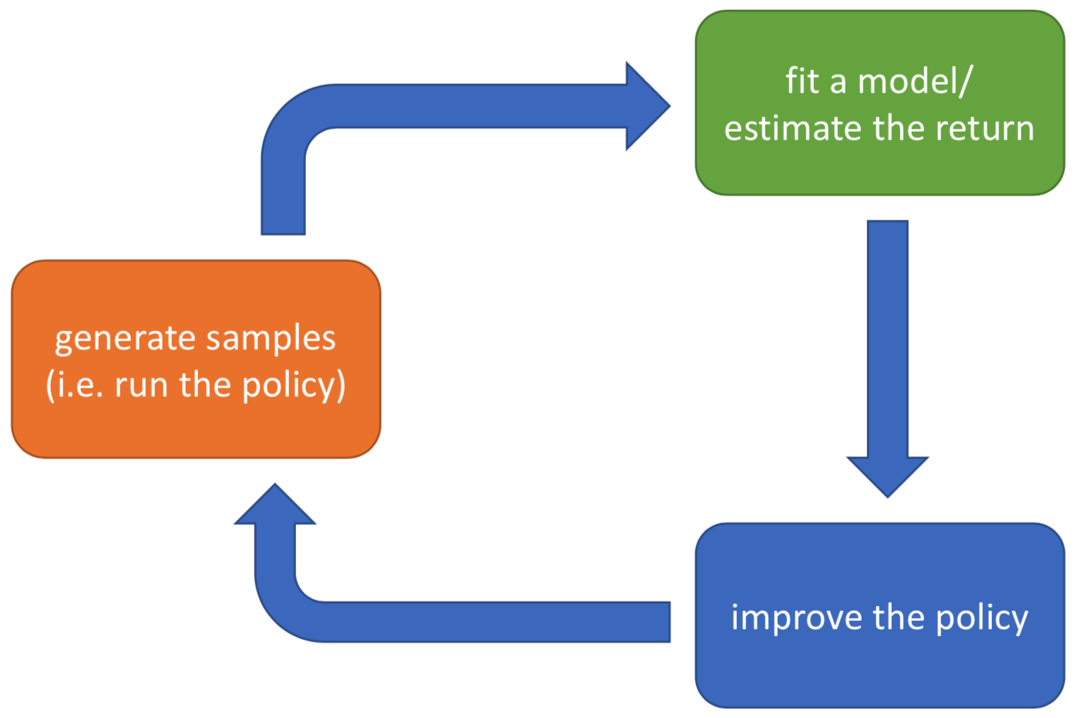
Methods
UT Dallas CS6301 Special Topics in Computer Science – Convolutional Neural Networks
Model free methods
Value based
Policy based
Combined value and policy based
Will include these with the policy based methods
As this is how they’re commonly presented
Model methods
Tree search
Can still use value and policy functions
Note
Only a few examples of the different methods are covered in these slides, many more variations exist
Figure from http://rail.eecs.berkeley.edu/deeprlcourse/static/slides/lec-4.pdf

Slide 20
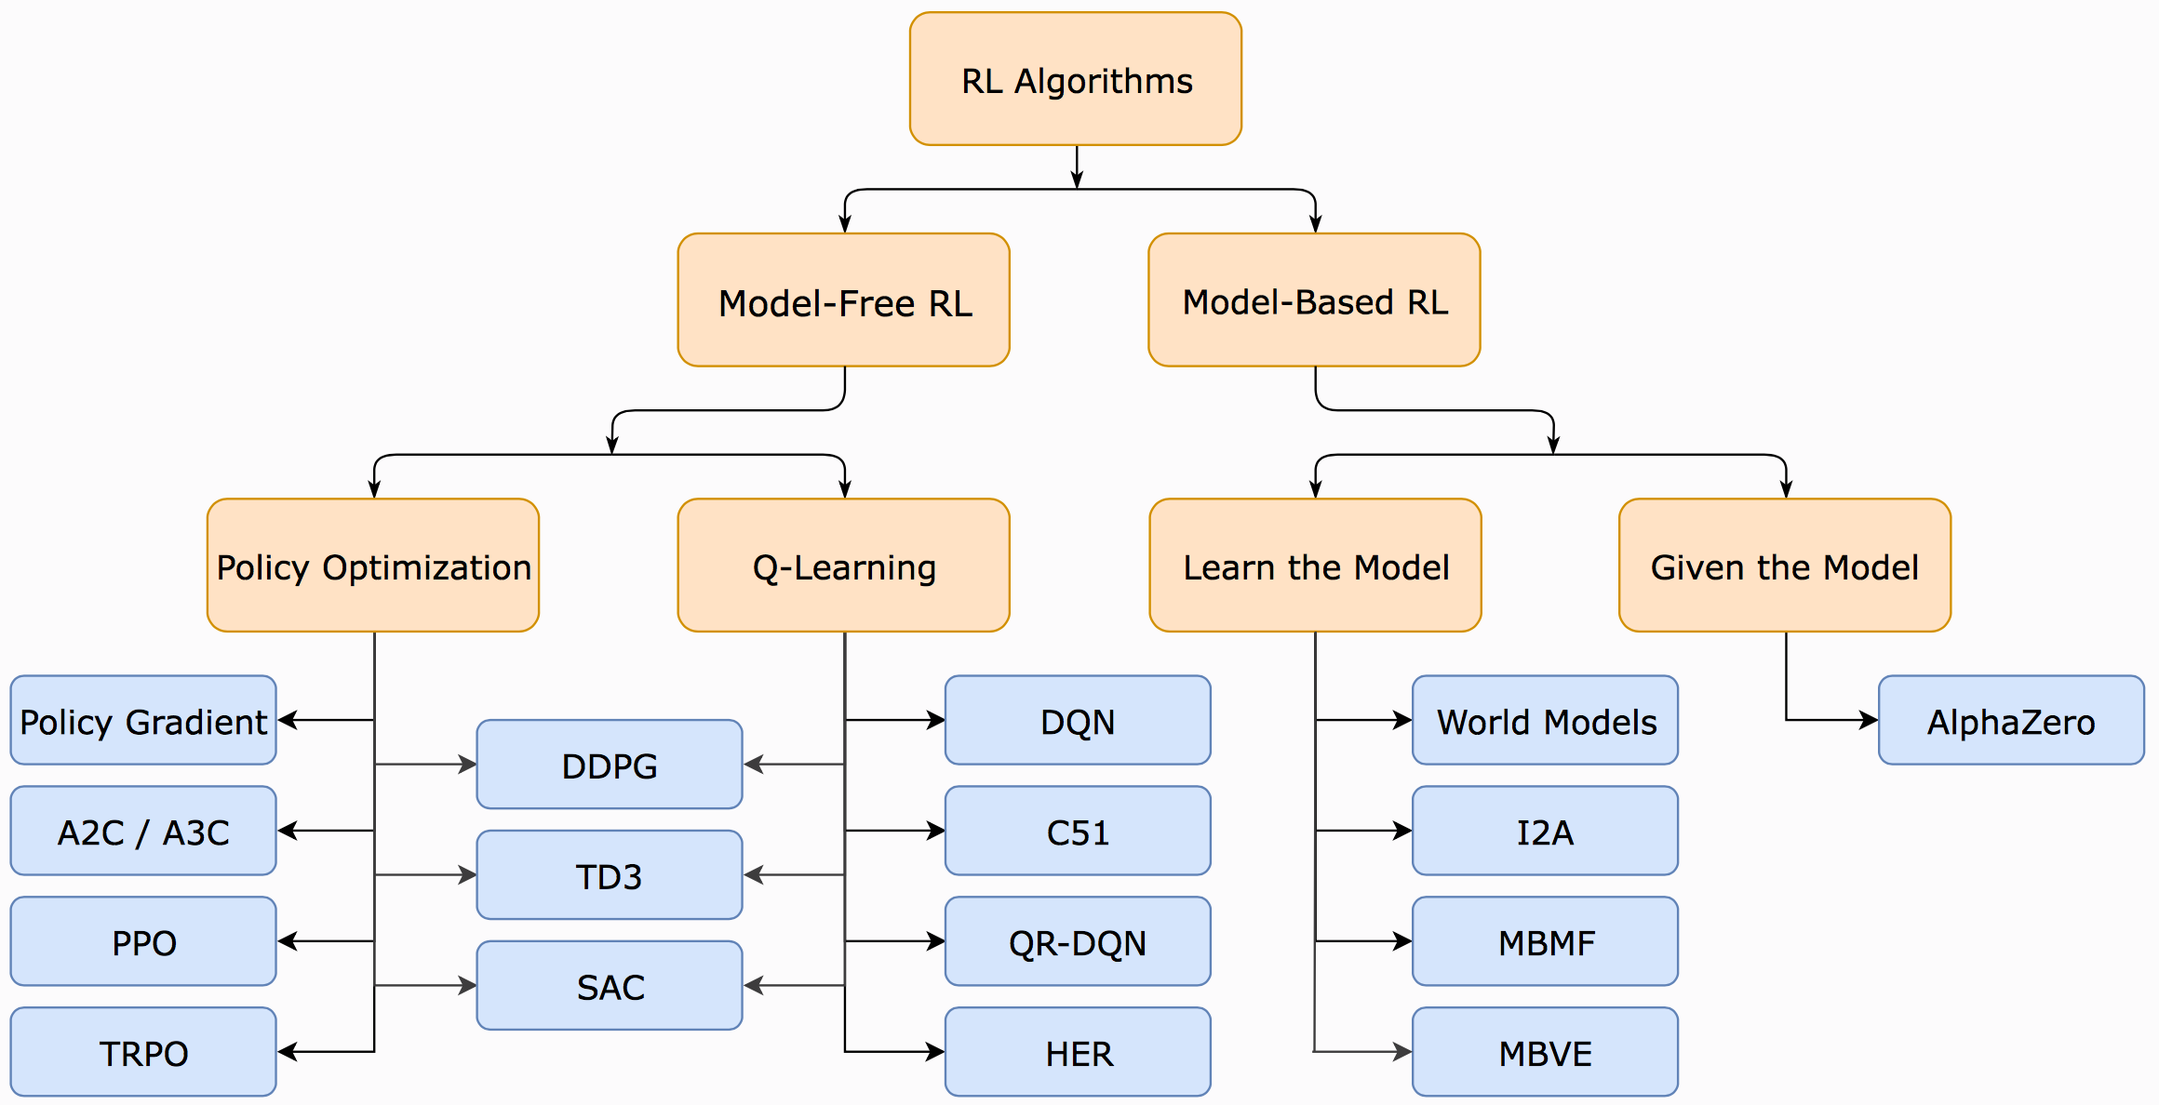
Methods
UT Dallas CS6301 Special Topics in Computer Science – Convolutional Neural Networks
Model free methods
Value based
Policy based
Combined value and policy based
Will include these with the policy based methods
As this is how they’re commonly presented
Model methods
Tree search
Can still use value and policy functions
Note
Only a few examples of the different methods are covered in these slides, many more variations exist
Note
This list is not comprehensive
We’ll still only discuss a fraction of this list
Figure from https://spinningup.openai.com/en/latest/spinningup/rl_intro2.html

Slide 21
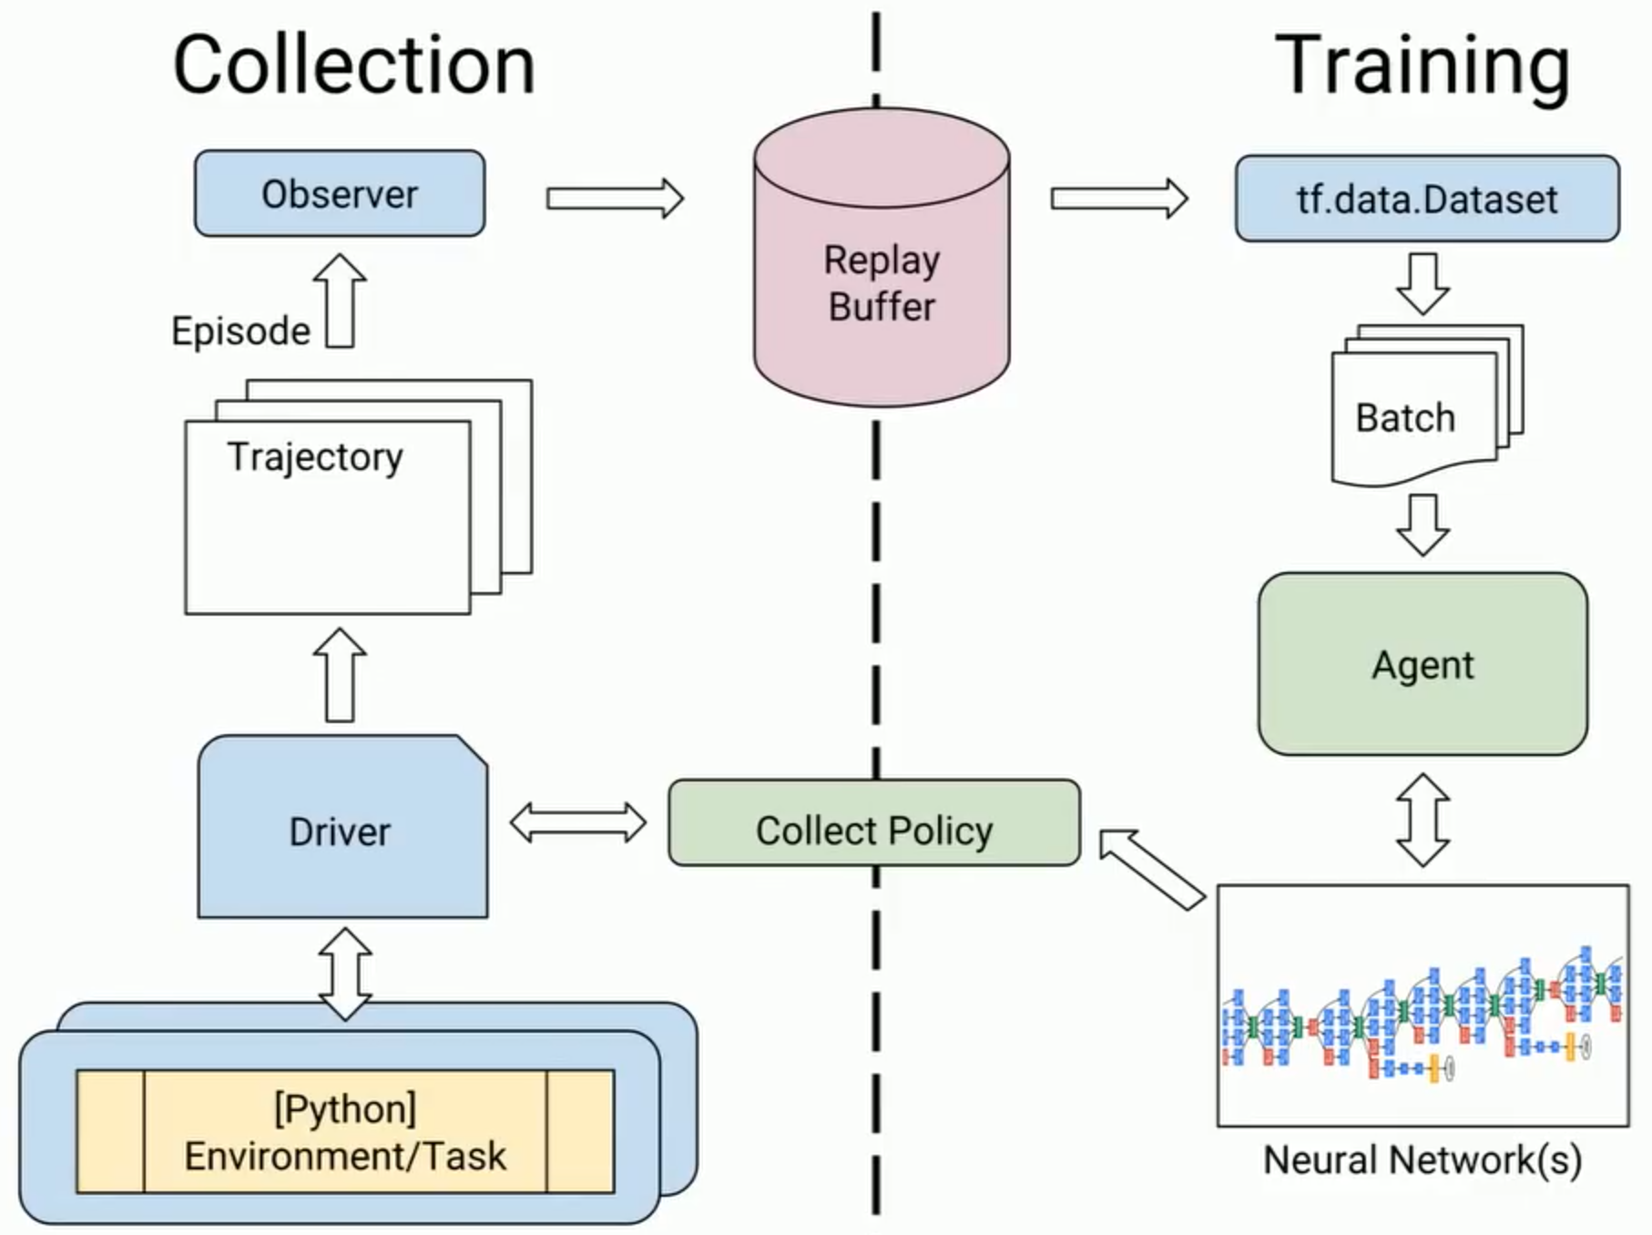
Sample Efficiency
UT Dallas CS6301 Special Topics in Computer Science – Convolutional Neural Networks
A measure of how many samples (number of times that the policy needs to be run) to get a good policy
Off policy methods
Methods that can improve a policy without generating new samples from the policy
On policy methods
Every time the policy is changed new samples need to be generated to further improve the policy
Figure from https://www.youtube.com/watch?v=-TTziY7EmUA

Slide 22
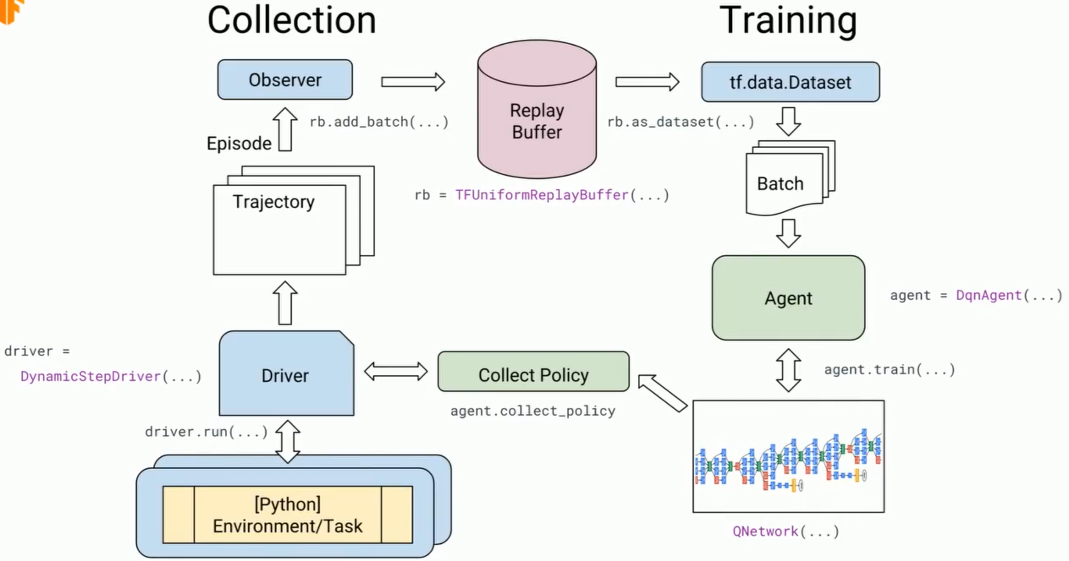
Sample Efficiency
UT Dallas CS6301 Special Topics in Computer Science – Convolutional Neural Networks
A measure of how many samples (number of times that the policy needs to be run) to get a good policy
Off policy methods
Methods that can improve a policy without generating new samples from the policy
On policy methods
Every time the policy is changed new samples need to be generated to further improve the policy
TensorFlow is adding a number of reinforcement learning related library components related to data collection and agent training, for additional information see:
TF-Agents: a library for reinforcement learning in TensorFlow
https://github.com/tensorflow/agents
https://github.com/tensorflow/agents/tree/master/tf_agents/colabs
Reinforcement learning in TensorFlow with TF-Agents (TF Dev Summit ‘19)
https://www.youtube.com/watch?v=-TTziY7EmUA
Figure from https://www.youtube.com/watch?v=-TTziY7EmUA

Slide 23
Examples
UT Dallas CS6301 Special Topics in Computer Science – Convolutional Neural Networks
Learning is slow and an agent makes lots of "mistakes”
So it's ideal to learn in a simulated environment that's as close to the real environment as possible for things that matter
This is where reinforcement learning has been most successful

Slide 24
Decision Making – Value Based
UT Dallas CS6301 Special Topics in Computer Science – Convolutional Neural Networks

Slide 25
Strategy
UT Dallas CS6301 Special Topics in Computer Science – Convolutional Neural Networks
Core idea
Approximate Q*(s_{t}, a_{t}) with Q_{Θ}(s_{t}, a_{t})
This gives the maximum expected reward for every state action pair
Select current action a_{t} = arg max_{a_t} Q_{Θ}(s_{t}, a_{t}) resulting in the maximum expected reward
Comments
This is indirectly optimizing what you want (the optimal action for a given state)
The Bellman equation is typically used in a fixed point setting for approximating Q*(s_{t}, a_{t})
This has failure modes → convergence to the optimal value is not guaranteed

Slide 26
Q Tables And Functions
UT Dallas CS6301 Special Topics in Computer Science – Convolutional Neural Networks
Q table
Use when there are a small number of states * actions
Q function
Use when there are a large number of states * actions but a small number of actions (i.e., the state space is large but the action space is small)

Slide 27
Q Learning Via A Fixed Point Equation
UT Dallas CS6301 Special Topics in Computer Science – Convolutional Neural Networks
Q learning fixed point iteration
Initialize Q(s, a)
Loop
Choose an action a based on state s and Q(s, a)
Typically favor the action with the largest Q(s, a) value (exploit)
Sometimes take a random action (explore)
From the environment receive a reward r and new state s_{new}
Update entry Q(s, a) in the Q table
Q(s, a) ← Q(s, a) + α(r + ɣ max_{a_new} Q(s_{new} , a_{new}) – Q(s, a))
When Q(s, a) converges to the fixed point the update term on the RHS should be 0
Comments
The Bellman equation allows us to find a valid Q function
The max allows us to increase the Q function towards Q* each iteration

Slide 28
Exploitation Vs Exploration
UT Dallas CS6301 Special Topics in Computer Science – Convolutional Neural Networks
When learning you’re effectively deciding between taking the action with the largest Q vs taking a random action
The epsilon greedy approach to exploitation vs exploration during training
Let |A| be the number of possible actions
Assign the following probabilities to actions
Random actions each have probability ϵ /|A|
The best action has probability 1 – ϵ
Use a value of ϵ close to 1 in the beginning (favor exploring)
As time goes by shrink ϵ to close to 0 at the end (favor exploiting)

Slide 29
Deep Q Network (DQN)
UT Dallas CS6301 Special Topics in Computer Science – Convolutional Neural Networks
Strategy
A xNN with parameters Θ is used to map from state s_{t} to Q_{Θ}(s_{t}, a_{t}), approximating Q*(s_{t}, a_{t}), and action a_{t} is selected corresponding to the maximum Q_{Θ}(s_{t}, a_{t})
Training data is collected via experience replay using an epsilon greedy approach to action selection and presented in randomized batches
A regression style loss is constructed via the Bellman equation
Parameters Θ are updated via gradient descent
This is all standard xNN stuff
Just applied to a different type of problem with a few tricks for collecting data and computing losses

Slide 30
Data
UT Dallas CS6301 Special Topics in Computer Science – Convolutional Neural Networks
Experience replay
At each time step get experience (s_{t}, a_{t}, r_{t}, s_{t+1}) and save it to a buffer
Collect and save experience with any / all of the policies throughout the learning process; note the efficient collection and use of data
During learning select random batches (to break up correlations)
Modifications / improvements to Q learning modify the batch selection
Prioritized experience replay
Select rare or important experiences more often (i.e., bias the batch selection)
Sample experience j ~ Pr(j) = p_{j}^{α}/Σ_{i}p_{j}^{α}
Update experience probability p_{j} = |target – output| (see subsequent slides) after computing error
Biases the sampling to experiences that have larger errors
Modify the gradient calculation to account for the biased sampling

Slide 31
Loss
UT Dallas CS6301 Special Topics in Computer Science – Convolutional Neural Networks
Error
e_{t} = 0.5 ((r_{t} + ɣ Q_{Θ}(s_{t+1} , arg max_{a_t+1} Q_{Θ}(s_{t+1} , a_{t+1}))) – Q_{Θ}(s_{t} , a_{t}))² target output
Note the target – output form of the error
Modifications / improvements to Q learning shown in the next slides will change the target
Gradient
∂e_{t}/∂Θ = ((r_{t} + ɣ Q_{Θ}(s_{t+1} , arg max_{a_t+1} Q_{Θ}(s_{t+1} , a_{t+1}))) – Q_{Θ}(s_{t} , a_{t})) ∂Q_{Θ}(s_{t} , a_{t})/∂Θ
Error sensitivity with respect to parameters
The high level library can compute an error gradient of end to end differentiable Q_{Θ} functions using automatic differentiation with reverse mode accumulation
Parameter update
Θ ← Θ – α ∂e_{t}/∂Θ
Standard gradient descent (as always, other variants possible)

Slide 32
A Fixed Target For The Loss
UT Dallas CS6301 Special Topics in Computer Science – Convolutional Neural Networks
This is the loss used in the deep Q network paper
Note that in the previous error both the target and output are updated every iteration
Target: r_{t} + ɣ Q_{Θ}(s_{t+1} , arg max_{a_t+1} Q_{Θ}(s_{t+1} , a_{t+1}))
Output: Q_{Θ}(s_{t} , a_{t})
It was observed that training stability improved if fixed targets are used
The output network was updated every iteration but
The target network was held fixed for T iterations then updated
Using Θ– to indicated the parameters of the target network
Target: r_{t} + ɣ Q_{Θ}-(s_{t+1} , arg max_{a_t+1} Q_{Θ}-(s_{t+1} , a_{t+1}))

Slide 33
Double DQN Target For The Loss
UT Dallas CS6301 Special Topics in Computer Science – Convolutional Neural Networks
Another modification to the loss
Fixed targets can overestimate the Q values when noisy
To prevent this can use 2 networks, 1 for the target and 1 for the output
Training is improved for some applications
In practice these can be combined into 1 network with different updates as below
Target: r_{t} + ɣ Q_{Θ}-(s_{t+1} , arg max_{a_t+1} Q_{Θ}(s_{t+1} , a_{t+1}))

Slide 34
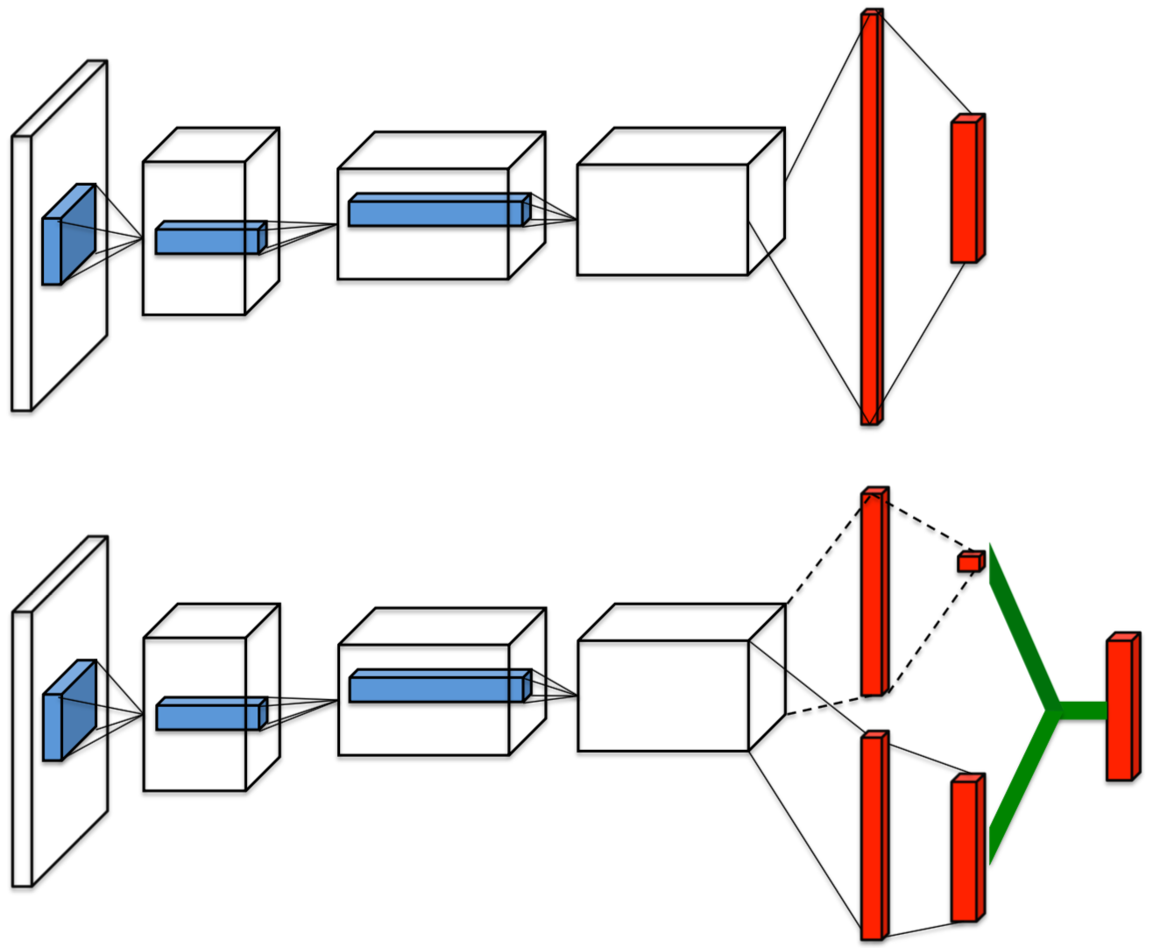
Dueling DQN Network Modifications
UT Dallas CS6301 Special Topics in Computer Science – Convolutional Neural Networks
An improvement to the network structure for estimating Q values
Common tail and body
Then 2 heads for estimating V and A
1 for estimating value V(s), a single value
1 for estimating advantage A(s, a), a vector of length |A|
Followed by their combination to compute Q
Q(s, a) = V(s) + A(s, a) – 1/|A| Σ_{a’} A(s, a’)
So this combination is really Q off by a scale factor but that’s ok
This can improve stability

Slide 35
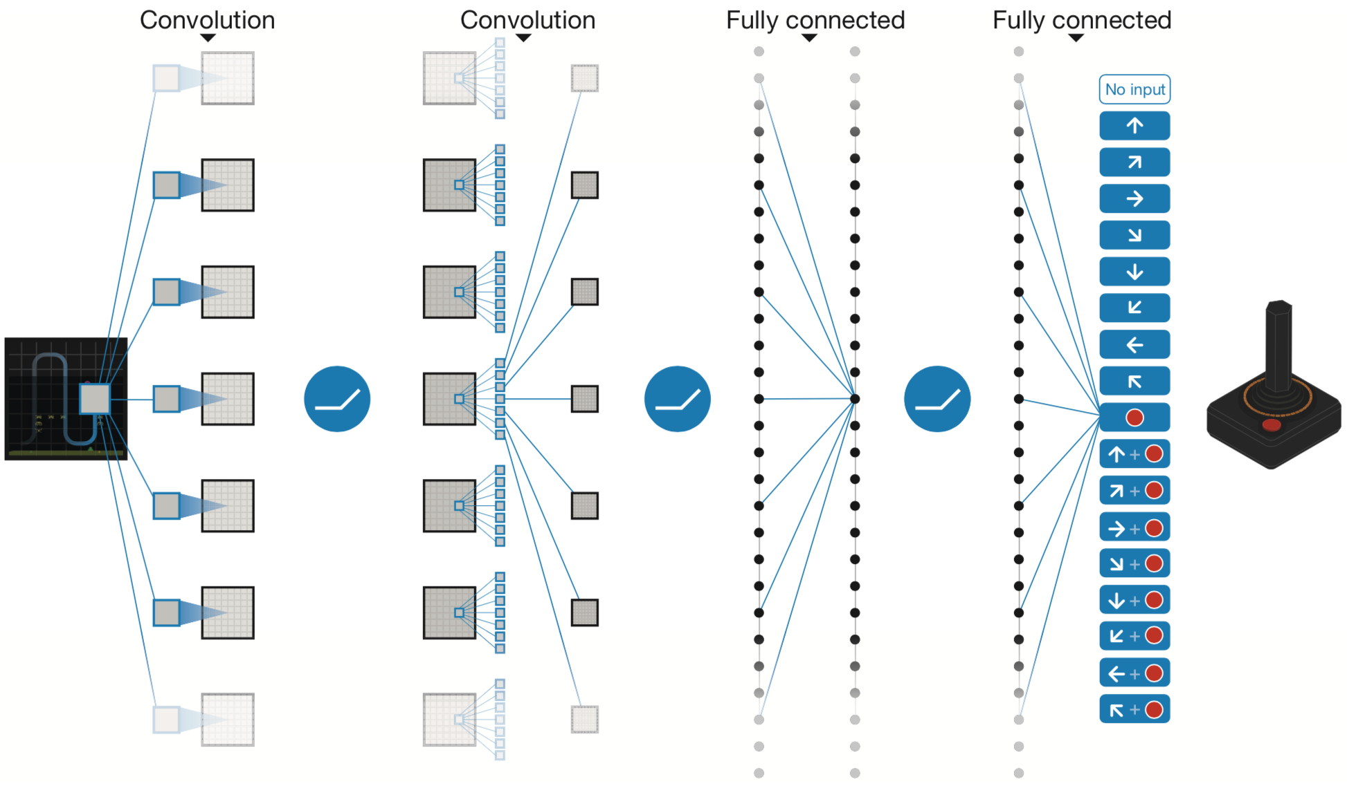
Example: Atari 2600 Games
UT Dallas CS6301 Special Topics in Computer Science – Convolutional Neural Networks
The following description and results are from the original Nature paper
This does not include all of the subsequent enhancements described on the previous pages
Regardless, it serves as a starting point for thinking about applying Q learning to Atari
Environment
Atari 2600 simulator
Input state s
Pre processing takes max over current and previous frame to catch flickering objects, extracts the luminance channel and rescales it to 84 x 84, then stacks the most recent 4 frames together
Result is 4 x 84 x 84 input that represents state
Note that the stack of 4 frames encodes motion
Inputs are generated once for every 4 frames to save on computation
Figure from https://storage.googleapis.com/deepmind-media/dqn/DQNNaturePaper.pdf

Slide 36
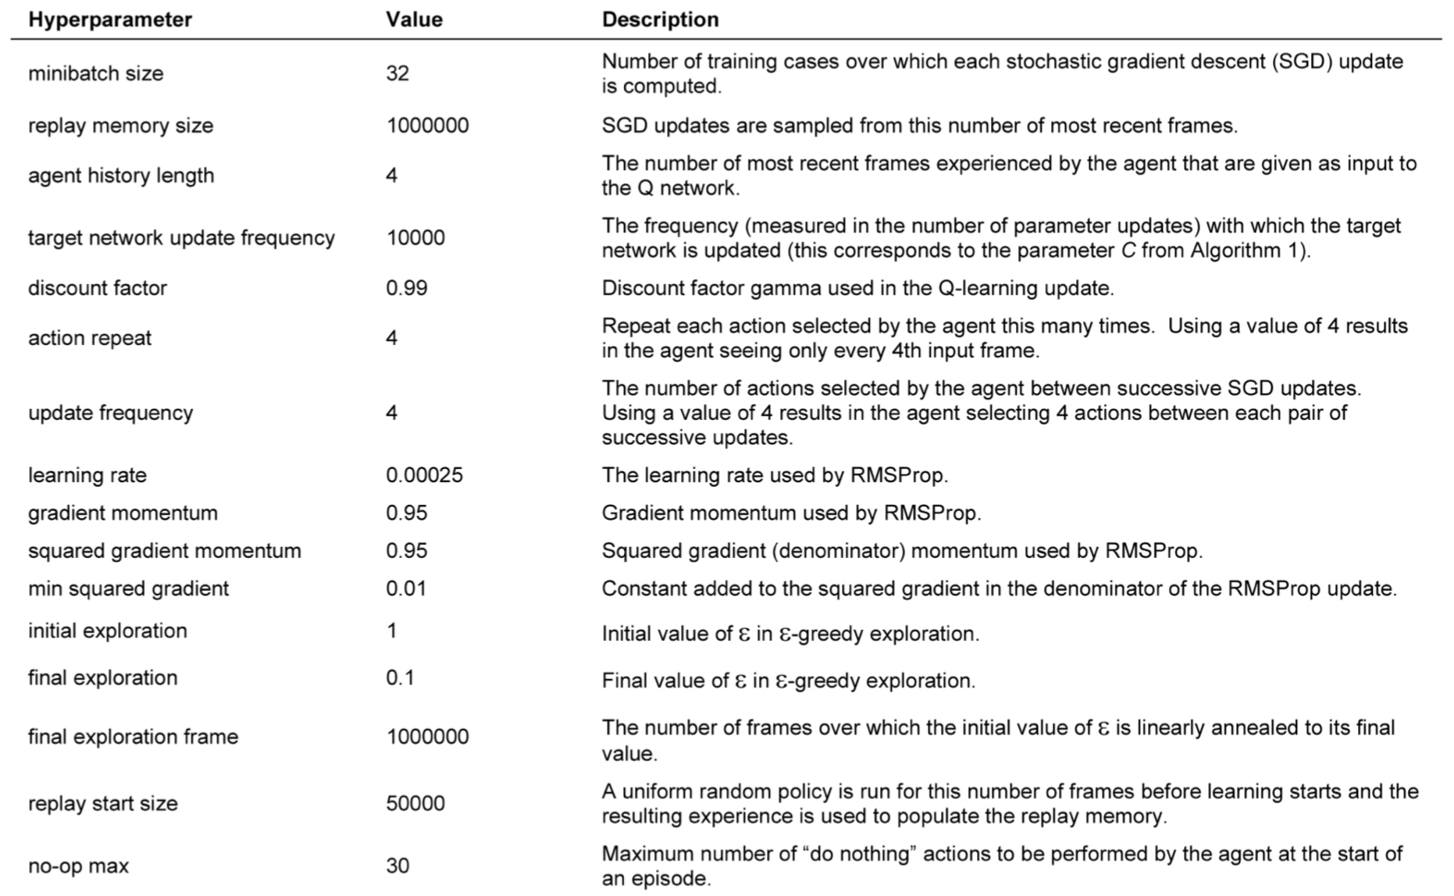
Example: Atari 2600 Games
UT Dallas CS6301 Special Topics in Computer Science – Convolutional Neural Networks
The network maps input state s to Q(s, a)
CNN layer with 32 x 4 x 8 x 8 / 4 filters and ReLU
CNN layer with 64 x 32 x 4 x 4 / 2 filters and ReLU
CNN layer with 64 x 64 x 3 x 3 / 1 filters and ReLU
Flatten
Fully connected layer with 512 outputs and ReLU
Fully connected layer with |A| outputs each corresponding to the Q value for a specific action
4 ≤ |A| ≤ 18 depending on the game
Reward r
Score change, limited to {-1, 0, 1}
Discount factor ɣ = 0.99
Loss
Fixed target loss
Google DeepMind's deep Q-learning playing Atari Breakout
https://www.youtube.com/watch?v=V1eYniJ0Rnk
Figure from https://storage.googleapis.com/deepmind-media/dqn/DQNNaturePaper.pdf

Slide 37
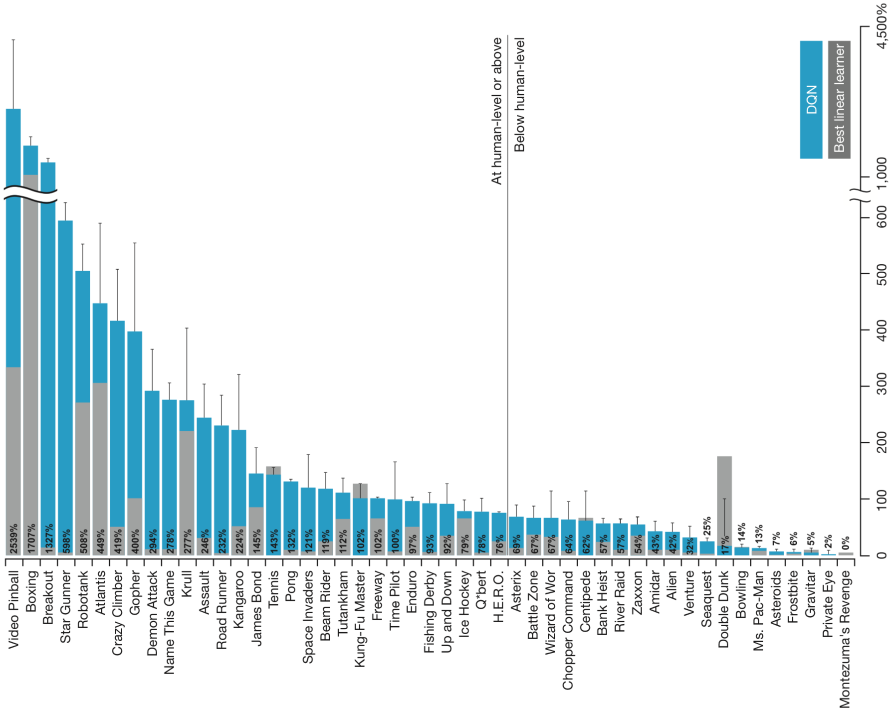
Example: Atari 2600 Games
UT Dallas CS6301 Special Topics in Computer Science – Convolutional Neural Networks
Figure from https://storage.googleapis.com/deepmind-media/dqn/DQNNaturePaper.pdf

Slide 38
Decision Making – Policy Based
UT Dallas CS6301 Special Topics in Computer Science – Convolutional Neural Networks

Slide 39
Strategy
UT Dallas CS6301 Special Topics in Computer Science – Convolutional Neural Networks
Core idea
The expected reward for following policy π is J(π) = ∫_{τ} Pr(τ | a ~ π) R_{0:}(τ) = E[R_{0:}(τ) | τ ~ π]
π* = arg max_{π} J(π) is the optimal policy that maximizes the expected reward
Approximate the optimal policy π* with a xNN based policy π_{Θ} with parameters Θ
Update the policy π_{Θ} during training to increase the expected reward
The basic REINFORCE algorithm
Run the policy and create samples (trajectories τ)
Estimate the policy gradient ∇_{Θ} J(π_{Θ})
Update the parameters Θ via gradient ascent or variant Θ_{k+1} = Θ_{k} + α ∇_{Θ} J(π_{Θ})
Repeat
Question: what is the policy gradient ∇_{Θ} J(π_{Θ}) and how do you estimate it?

Slide 40
Policy Gradients
UT Dallas CS6301 Special Topics in Computer Science – Convolutional Neural Networks
The policy gradient is the change in the expected reward J(π_{Θ}) for a small change in Θ evaluated at the current Θ
∇_{Θ} J(π_{Θ}) = E[∇_{Θ} log p_{P}(τ) R_{0:}(τ) | τ ~ π_{Θ}] = E[(Σ_{t=0:T-1}∇_{Θ} log p_{π_Θ}(a_{t} | s_{t})) R_{0:}(τ) | τ ~ π_{Θ}] = E[(Σ_{t=0:T-1}∇_{Θ} log p_{π_Θ}(a_{t} | s_{t})) (Σ_{i=0:T-1}R(s_{i}, a_{i})) | τ ~ π_{Θ}] ≈ (1/N) Σ_{n=0:N-1}((Σ_{t=0:T-1}∇_{Θ} log p_{π_Θ}(a_{n,t} | s_{n,t})) (Σ_{i=0:T-1}R(s_{n,i}, a_{n,i})))
For the derivation of the above policy gradient see the appendix
Need to compute ∇_{Θ} log p_{π_Θ}(a_{t} | s_{t})
∇_{Θ} log p_{π_Θ}(a_{t} | s_{t}) computation strategy
For categorical policies the network output is an |A| x 1 vector p_{π_Θ}(a_{t} | s_{t})
Take the log of this, then apply auto diff
For diagonal Gaussian policies the network output is a mean action vector
Converted to a continuous action via the previously described procedure
Take the log of this, then apply auto diff

Slide 41
Policy Gradients
UT Dallas CS6301 Special Topics in Computer Science – Convolutional Neural Networks
A key issue is the variance in the estimation of ∇_{Θ} J(π_{Θ})
Subsequent slides will look at methods for reducing the variance
Most of the described strategies work by modifying the R_{0:}(τ) term
For the justification for these modifications see the EGLP lemma in the appendix

Slide 42
Reward To Go
UT Dallas CS6301 Special Topics in Computer Science – Convolutional Neural Networks
The R_{0:}(τ) term in the policy gradient weights all actions based on the total reward
But it doesn’t make sense to reinforce future actions based on previous rewards
The reward to go modifies the objective to only include rewards from the present or future
This is done by replacing R_{0:}(τ) with R_{t:}(τ)
Reward to go policy gradient
∇_{Θ} J(π_{Θ}) = E[∇_{Θ} log p_{P}(τ) R_{t:}(τ) | τ ~ π_{Θ}] = E[Σ_{t=0:T-1}∇_{Θ} log p_{π_Θ}(a_{t} | s_{t}) Σ_{i=t:T-1}R(s_{i}, a_{i}) | τ ~ π_{Θ}]

Slide 43
Baseline Removal
UT Dallas CS6301 Special Topics in Computer Science – Convolutional Neural Networks
A further modification to the reward to go R_{t:}(τ) is the removal of a baseline
When the baseline is chosen as the value function the expected average return is removed from the reward to weight the policy updates based on the improvement relative to the average reward
This is appealing
The resulting algorithm has 2 parts, an actor (the policy) and a critic (the value function) and is referred to as an actor critic algorithm
Policy gradient with value function baseline removal
∇_{Θ} J(π_{Θ}) = E[∇_{Θ} log p_{P}(τ) (R_{t:}(τ) – V^{π_Θ}(s_{t})) | τ ~ π_{Θ}] = E[Σ_{t=0:T-1}∇_{Θ} log p_{π_Θ}(a_{t} | s_{t}) (Σ_{i=t:T-1}R(s_{i}, a_{i}) – V^{π_Θ}(s_{t})) | τ ~ π_{Θ}]
Removing the baseline value function requires an estimate of the value function
This is typically done using another xNN, V_{ɸ}(s_{t}), that approximates V^{π_Θ}(s_{t})
The value function xNN is trained at the same time via the following objective
ɸ = arg min_{ɸ} E[(V_{ɸ}(s_{t}) – R_{t:}(τ))² | τ ~ π_{Θ}]

Slide 44
Advantage Function
UT Dallas CS6301 Special Topics in Computer Science – Convolutional Neural Networks
Replacing the reward term with the Q function results in the advantage function being used for the weighting term
Policy gradient with advantage function
∇_{Θ} J(π_{Θ}) = E[∇_{Θ} log p_{P}(τ) (Q^{π_Θ}(s_{t}, a_{t}) – V^{π_Θ}(s_{t})) | τ ~ π_{Θ}] = E[Σ_{t=0:T-1}∇_{Θ} log p_{π_Θ}(a_{t} | s_{t}) A^{π_Θ}(s_{t}, a_{t}) | τ ~ π_{Θ}]
Note that Q^{π_Θ}(s_{t}, a_{t}) = r_{t} + ɣV^{π_Θ}(s_{t+1})
As before, V^{π_Θ}(s_{t}) is estimated via another xNN, V_{ɸ}(s_{t})

Slide 45
Vanilla Policy Gradient Algorithm
UT Dallas CS6301 Special Topics in Computer Science – Convolutional Neural Networks
Initialize
Policy parameters Θ₀ and value function parameters ɸ₀
Loop for k = 0 to ...
Collect a set of N trajectories {τ_{n}}_{n=0:N-1} by running the policy p_{π_Θ}(a_{t} | s_{t}) in the environment
Compute the rewards to go R_{t:}(τ_{n})
Compute the advantage function from the individual rewards and estimated value function
A^{π_Θk}(s_{n,t}, a_{n,t}) = R(s_{n,t}, a_{n,t}) + ɣV_{ɸk}(s_{t+1}) – V_{ɸk}(s_{t})
This is a 0 step estimate, multi step and generalized advantage estimates are also possible
Estimate the policy gradient
∇_{Θk} J(π_{Θk}) = (1/N) Σ_{n=0:N-1} (Σ_{t=0:T-1}∇_{Θk} log p_{π_Θk}(a_{n,t} | s_{n,t}) A^{π_Θk}(s_{n,t}, a_{n,t}))
Update the policy parameters via stochastic gradient ascent or variant
Θ_{k+1} = Θ_{k} + α ∇_{Θk} J(π_{Θk})
Update the value function via gradient descent or variant based on the MSE
ɸ_{k+1} = arg min_{ɸ} (1/N) Σ_{n=0:N-1} (V_{ɸ}(s_{t}) – R_{t:}(τ_{n}))²

Slide 46
Decision Making – Model Based
UT Dallas CS6301 Special Topics in Computer Science – Convolutional Neural Networks

Slide 47
Strategy
UT Dallas CS6301 Special Topics in Computer Science – Convolutional Neural Networks
Basic idea
Learn a model
For a MDP this means learning the state transition function and reward function
Note that it may be given or need to be estimated
Use the model to simulate various outcomes
An alternative use of this is to use the model to generate data for a model free based method
Choose an action that results in the best outcome
Maybe directly from the simulations
Maybe indirectly via a policy trained from the simulations
When action selection is done via a tree view of states and transitions
You need a method for deciding which nodes to assign a value to (what parts of the tree to explore)
You need a method for valuing those nodes
You need a method to select the next node based on the assigned values

Slide 48
How To Learn A Model
UT Dallas CS6301 Special Topics in Computer Science – Convolutional Neural Networks
A few possibilities
Supervised learning
Self play
The model is given
Note
An inaccurate model can lead to sub optimal decisions

Slide 49
An Example Model Learning Algorithm
UT Dallas CS6301 Special Topics in Computer Science – Convolutional Neural Networks
Initialization
Run a data collection policy π to collect an initial dataset {(s, a, s’)_{t}}_{t=0:T-1}
s’ is used to indicate the next state
Time can be continuous so t+1 wasn’t used
Learn a state transition model f(s, a) via minimizing Σ_{t=0:T-1}||f(s_{t}, a_{t}) – s_{t}’||²
Loop indefinitely
Loop for N steps
Plan by using f(s, a) to look into the future and select an optimal action
Execute the action and observe the resulting state s’
This may or may not be the predicted next state based on the model accuracy
Append the new piece of data (s, a, s’) to the dataset
Update the state transition model f(s, a) via minimizing Σ||f(s_{t}, a_{t}) – s_{t}’||² using the updated dataset

Slide 50
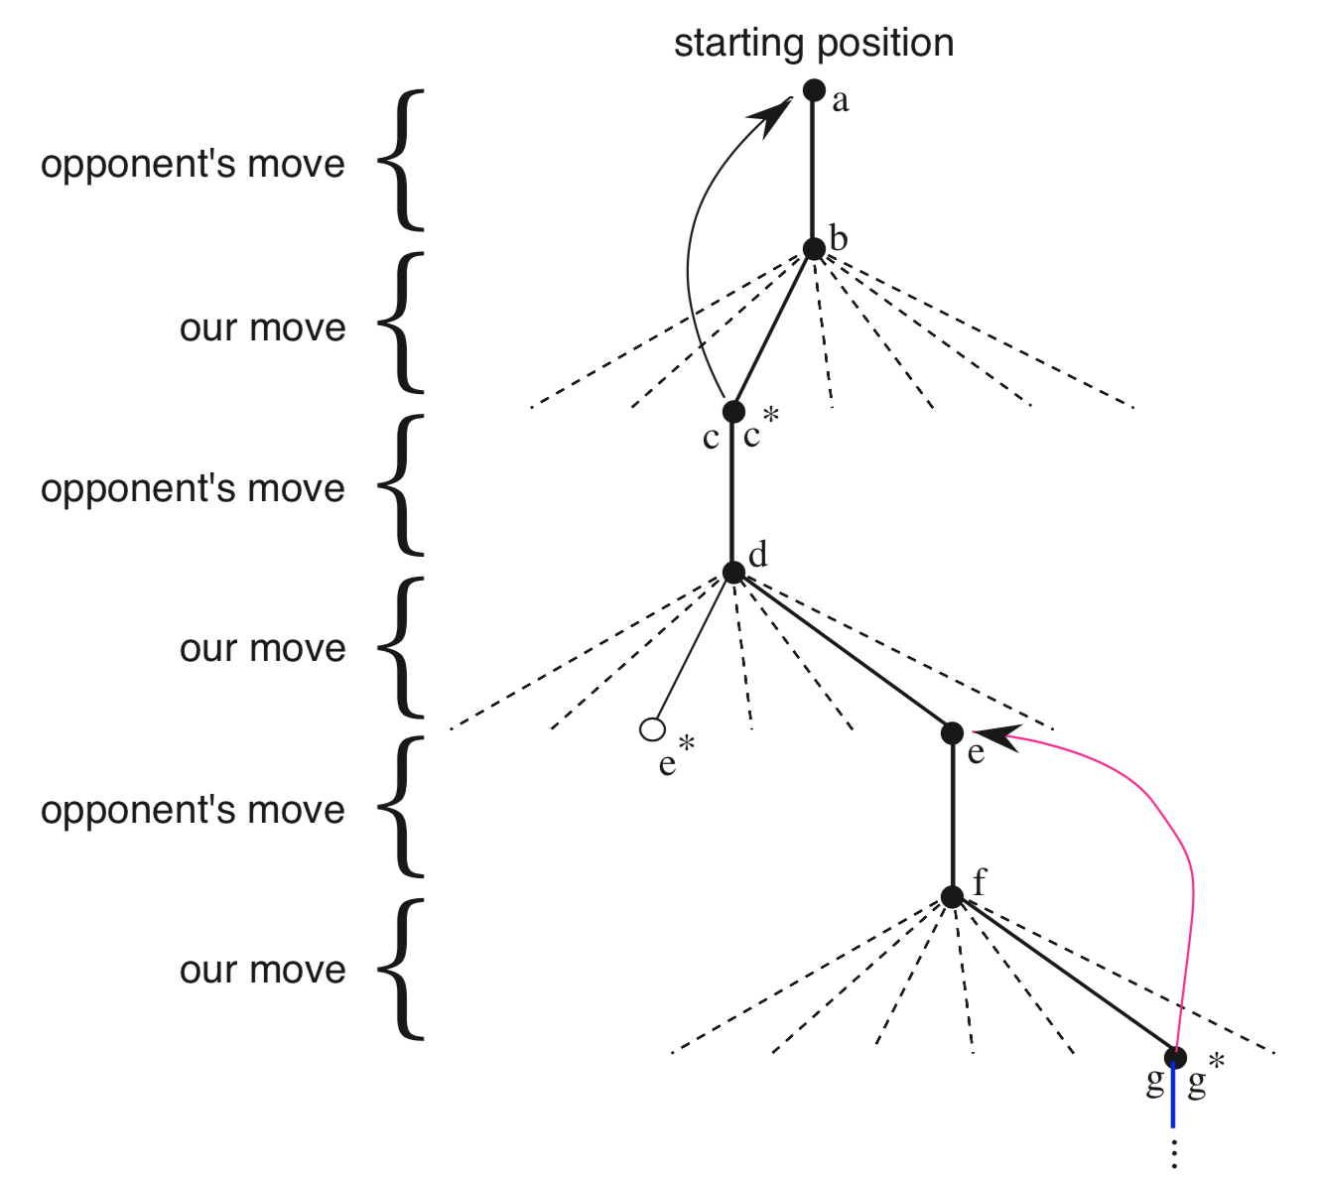
Viewing Games As Trees
UT Dallas CS6301 Special Topics in Computer Science – Convolutional Neural Networks
Brushing aside a lot of important formalism of game theory (please consult a reference if interested) ...
You can view a game as a tree
Each node in the tree is a state in the game
The root node is initial state
A leaf node is a terminal state
Nodes (states) have values
A move is a transition from a node to a child node
The number of child nodes is number of possible moves for the state
Figure from http://incompleteideas.net/book/bookdraft2017nov5.pdf

Slide 51
Policy From Value Assignment And Tree Search
UT Dallas CS6301 Special Topics in Computer Science – Convolutional Neural Networks
What is the optimal (move) child node to select?
To answer this question you need to have a value assigned to each child node of the root node
The optimal move would then be selecting the child node with the highest value
To assign a value to a child node of the root node you need to understand the sub tree under that child
The problem is that the sub tree becomes too large to fully expand in a brute force manner
So you have to decide what parts of the tree you want to explore to help you decide what child node to select
As such, the tree search method is a key
Figure from http://incompleteideas.net/book/bookdraft2017nov5.pdf

Slide 52
Fixed Depth Expansion + Value Estimation
UT Dallas CS6301 Special Topics in Computer Science – Convolutional Neural Networks
Consider a minimax strategy for selecting the next move (best child node) in a zero sum game
Assume your opponent plays optimally
You choose the strategy that maximizes your reward assuming that your opponent plays to minimize your reward (maximize their reward)
To solve this you would like to expand the full game tree from root to all leaves
But since you can’t, you instead fully expand the tree to a fixed depth corresponding to D moves
Then use Monte Carlo rollouts or other methods to estimate the value of all nodes at depth D, effectively treating them as leaves
Then apply minimax strategy from here

Slide 53
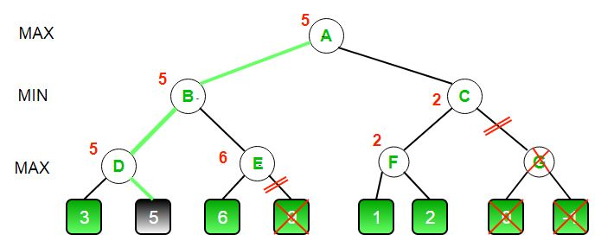
Alpha Beta Pruning To Reduce The Search
UT Dallas CS6301 Special Topics in Computer Science – Convolutional Neural Networks
Alpha beta pruning is a depth first method that decreases the number of nodes searched by the minimax algorithm via pruning the tree
Sub trees are pruned if a better move is available (a player would never choose that sub tree)
This implies that values for leaves are known (or estimated)
Alpha = the min score that the maximizing player is assured of
Beta = the max score that the minimizing player is assured of
Figure from https://www.geeksforgeeks.org/minimax-algorithm-in-game-theory-set-4-alpha-beta-pruning/

Slide 54
Monte Carlo Tree Search
UT Dallas CS6301 Special Topics in Computer Science – Convolutional Neural Networks
A different (not minimax) tree search strategy
Basic idea
Use MCTS to assign to a subset of all possible nodes
A total simulation reward Q
A total number of visits N
Note
All possible nodes includes all possible paths from the root node to all termination states
The subset includes all child nodes of the root node (all possible moves from the current state)
Select a move corresponding to a child node of the root node
Typically the most visited child
That corresponds to the most explored state
Noting that MCTS explores more promising states more of the time (will see soon)

Slide 55
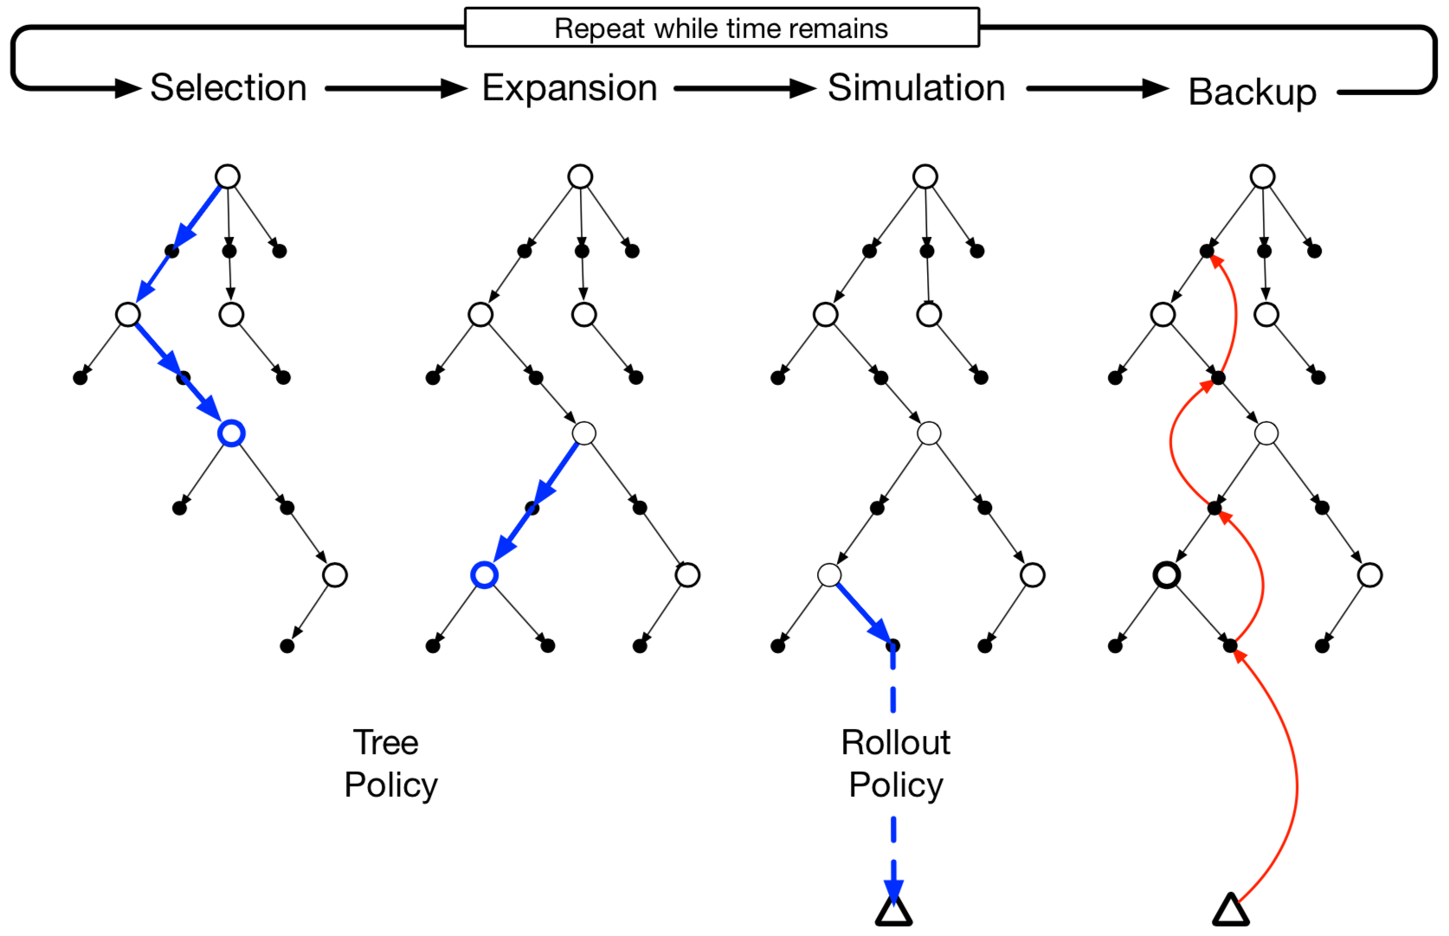
Monte Carlo Tree Search
UT Dallas CS6301 Special Topics in Computer Science – Convolutional Neural Networks
Figure from http://incompleteideas.net/book/bookdraft2017nov5.pdf

Slide 56
Monte Carlo Tree Search
UT Dallas CS6301 Special Topics in Computer Science – Convolutional Neural Networks
Definition: (non) fully expanded node
A node in which all of it’s children have (not) been visited
Step 1: Select an unvisited node
Start at the root
Search for a non fully expanded node (nota bene)
If the current node is fully expanded then choose it’s child with the highest UCT and repeat the search from there
UCT(node, parent) = Q(node)/N(node) + c*sqrt(log(N(parent))/N(node))
1st term favors exploitation
2nd term favors exploration (prevents collapse to greedy)
c is a constant to balance between the exploitation and exploration
There are variants of this
If the current node is not fully expanded then stop (you found a non fully expanded node)
Select an unvisited child of the non fully expanded node

Slide 57
Monte Carlo Tree Search
UT Dallas CS6301 Special Topics in Computer Science – Convolutional Neural Networks
Step 2: Simulate the selected unvisited node to get a value
Need a policy to chose moves (can be random or better) or another method to estimate a value
Mark this node as visited
A lower node through which the simulation passes is still considered unvisited
If all children of the parent are visited then mark the parent as fully expanded
Step 3: Back propagate (not calculus) the value from the selected node to the root and update encountered node statistics along the way
Q(node) = total simulation reward (e.g., add new value to current value of node)
N(node) = total number of visits (e.g., add 1 to the current value of the node)
Repeat steps 1 – 3 until sufficient statistics are built up / a time limit is reached
Will have Q(node) and N(node) values for many nodes in the tree including all children of the root node (the current state)

Slide 58
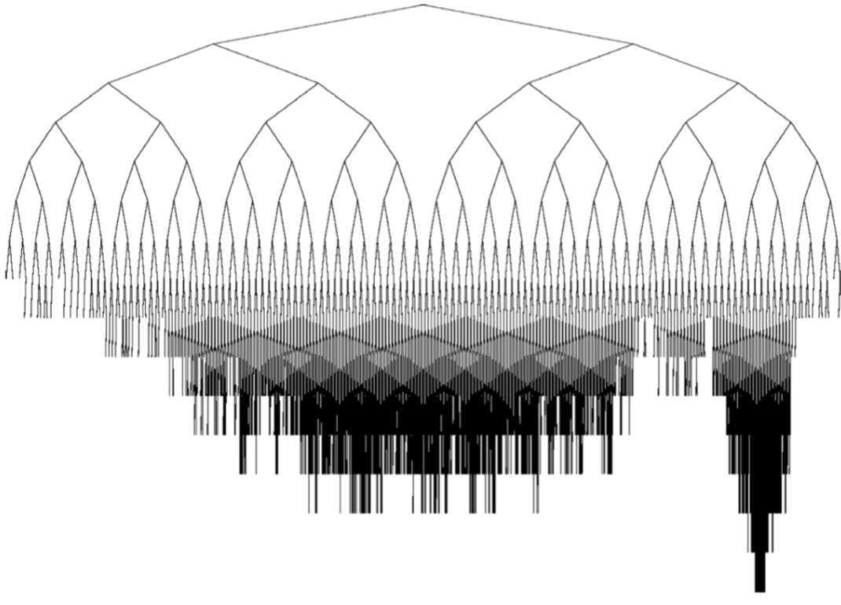
Monte Carlo Tree Search
UT Dallas CS6301 Special Topics in Computer Science – Convolutional Neural Networks
Step 4: Select a move
Effectively, creating a policy from the tree
Effectively, choosing a child of the root
Typically the child with the highest number of visits
This is the most explored move
MCTS biases exploration towards more favorable moves
Computation note
It’s likely possible to reuse parts of the previously created tree for the next move
Figure from https://ieeexplore.ieee.org/document/6145622

Slide 59
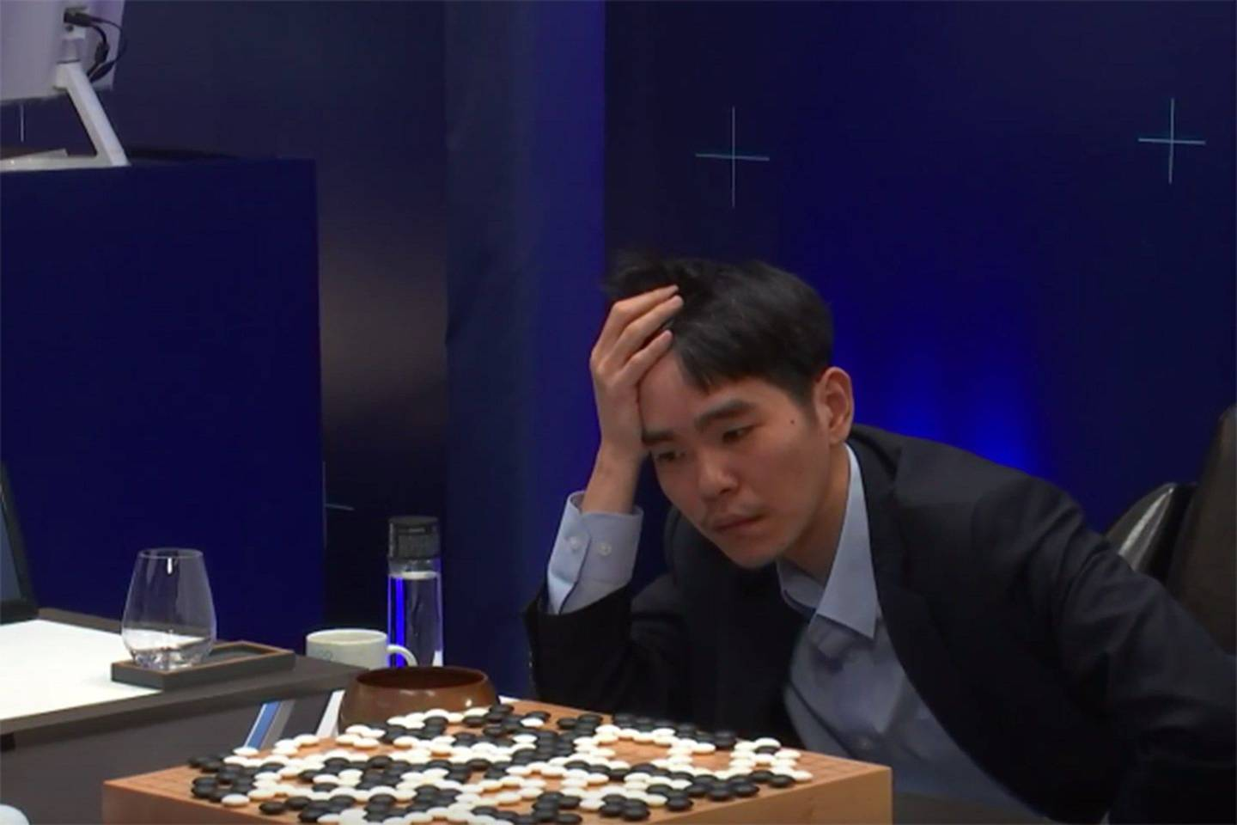
Example: Go
UT Dallas CS6301 Special Topics in Computer Science – Convolutional Neural Networks
Problem
There’s an optimal value for every board state that represents the outcome of the game assuming perfect play
Given ~ b = 250 possible moves per turn (breadth) and ~ d = 150 turns (depth) in a typical game an exhaustive search of b^{d} moves to determine the value of a state is infeasible
So you need a way to reduce the breadth and depth of the tree
Strategy
To reduce the implicit breadth of the tree use a policy xNN to predict a pmf over the possible moves from an input board state and select the highest probability moves for exploration, effectively making the tree less wide
To reduce the implicit depth of the tree use a value xNN to predict the value (game outcome) from an input board state, effectively making the tree less deep
Combine the policy and value xNNs with MCTS for training and game play
Figure from https://www.wired.co.uk/article/alphago-deepmind-google-wins-lee-sedol

Slide 60
Example: Go
UT Dallas CS6301 Special Topics in Computer Science – Convolutional Neural Networks
There were many prior approaches to playing Go that achieved varying results but included important components of an overall effective strategy
The Go slides will focus on 2 that achieved superhuman levels of play
AlphaGo (also known as AlphaGo Fan)
AlphaGo Lee
AlphaGo Master
AlphaGo Zero
Alpha Zero
Descriptions are approximate and many details are omitted, please see the original papers for full information

Slide 61
Example: Go
UT Dallas CS6301 Special Topics in Computer Science – Convolutional Neural Networks
AlphaGo
AlphaGo summary
Training step 1: supervised learning of 2 policy networks to predict expert human moves
Output 1: The SL policy network – a 13 layer CNN that maps board states to expert move pmfs
Output 2: The fast rollout policy network – a less accurate but faster neural network that maps board states to expert move pmfs
Training step 2: improvement of the policy network via reinforcement learning
Output: The RL policy network – an improvement of the SL policy network trained via iterative self play and using a policy gradient for the update
Training step 3: estimation of a value network via supervised learning
Output: The value network – a 13 layer CNN that maps the board state to a win / loss prediction for the game
Game play: MCTS enhanced via policy and value networks to select actions
The RL policy network is used to bias the UCT algorithm for node selection towards exploring better moves, implicitly reducing the tree breadth
The value network and fast rollout policy networks are used to value board states, implicitly reducing the tree depth
Select a move based on the child node of the root node with the highest number of visits, this is the most explored move and MCTS biases exploration towards more favorable moves

Slide 62
Example: Go
UT Dallas CS6301 Special Topics in Computer Science – Convolutional Neural Networks
AlphaGo
Training step 1: supervised learning of 2 policy networks to predict expert human moves
The SL policy network
The input is an encoded representation of the board state using a number of feature maps; some of the feature maps include needed information, some of the feature maps include human selected heuristics
The network is a 13 layer CNN
The output is a 19x19 grid representing a pmf for each possible move
Training is done via stochastic gradient descent to map input states to human moves using the KGS Go Server database of millions of human positions and moves (state action pairs) for data
Achieves mid 50% accuracy in 3 ms per input
The fast rollout policy network
The input is a different encoded representation of the board state; as before, some of the encoding is needed information, some of the encoding is human selected heuristics
A smaller network is used
The output is a 19x19 grid representing a pmf for each possible move
Achieves mid 20% accuracy in 2μs per input

Slide 63
Example: Go
UT Dallas CS6301 Special Topics in Computer Science – Convolutional Neural Networks
AlphaGo
Training step 2: improvement of the policy network via reinforcement learning
The RL policy network
Same structure and initialized via the SL policy network
A pool of previous versions of the RL policy network is maintained
Self play against a randomly selected previous version to stabilize training is used
The reward function is +1 for winning and -1 for losing the game
A policy gradient algorithm with stochastic gradient ascent is used to update the weights to improve the policy

Slide 64
Example: Go
UT Dallas CS6301 Special Topics in Computer Science – Convolutional Neural Networks
AlphaGo
Training step 3: estimation of a value network via supervised learning
The value network
For input and labeled output data millions of board states were sampled from games, the game was played from the sampled state by the final RL policy network against itself and the +1 winning / -1 losing result was recorded (so the RL trained policy network was used to generate labeled data)
The network is a 13 layer CNN
The output is a single value representing the predicted value of the game given the input board state
Training is done via stochastic gradient descent minimizing a square error loss

Slide 65
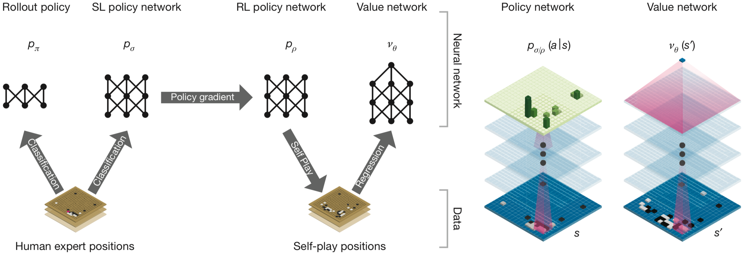
Example: Go
UT Dallas CS6301 Special Topics in Computer Science – Convolutional Neural Networks
AlphaGo
Figure from https://storage.googleapis.com/deepmind-media/alphago/AlphaGoNaturePaper.pdf

Slide 66
Example: Go
UT Dallas CS6301 Special Topics in Computer Science – Convolutional Neural Networks
AlphaGo
Game play: MCTS enhanced via policy and value networks to select actions
The following is an approximation / summary, please see the original paper for full details
Consider standard MCTS as a starting point
Use the RL policy network to modify the UCT used for node selection via biasing it towards stronger moves, effectively reducing the breadth of the tree
UCT(node, parent) = Q(node)/N(node) + c*Pr(parent, node)*sqrt(log(N(parent))/N(node))
Pr(parent, node) is the prior probability of the move from the RL policy network
Use the value network and fast rollout policy network to improve the node value assignment, effectively reducing the depth of the tree
The value at node S_{L} is a weighted sum of 2 parts
Part 1: z_{L} = result of the game using the fast rollout policy network
Part 2: v₀(S_{L}) = output of value network
Sum: V(S_{L}) = (1 – α)*v₀(S_{L}) + α*z_{L}
Select a move based on the child node of the root node with the highest number of visits
This is the most explored move
MCTS biases exploration towards more favorable moves

Slide 67
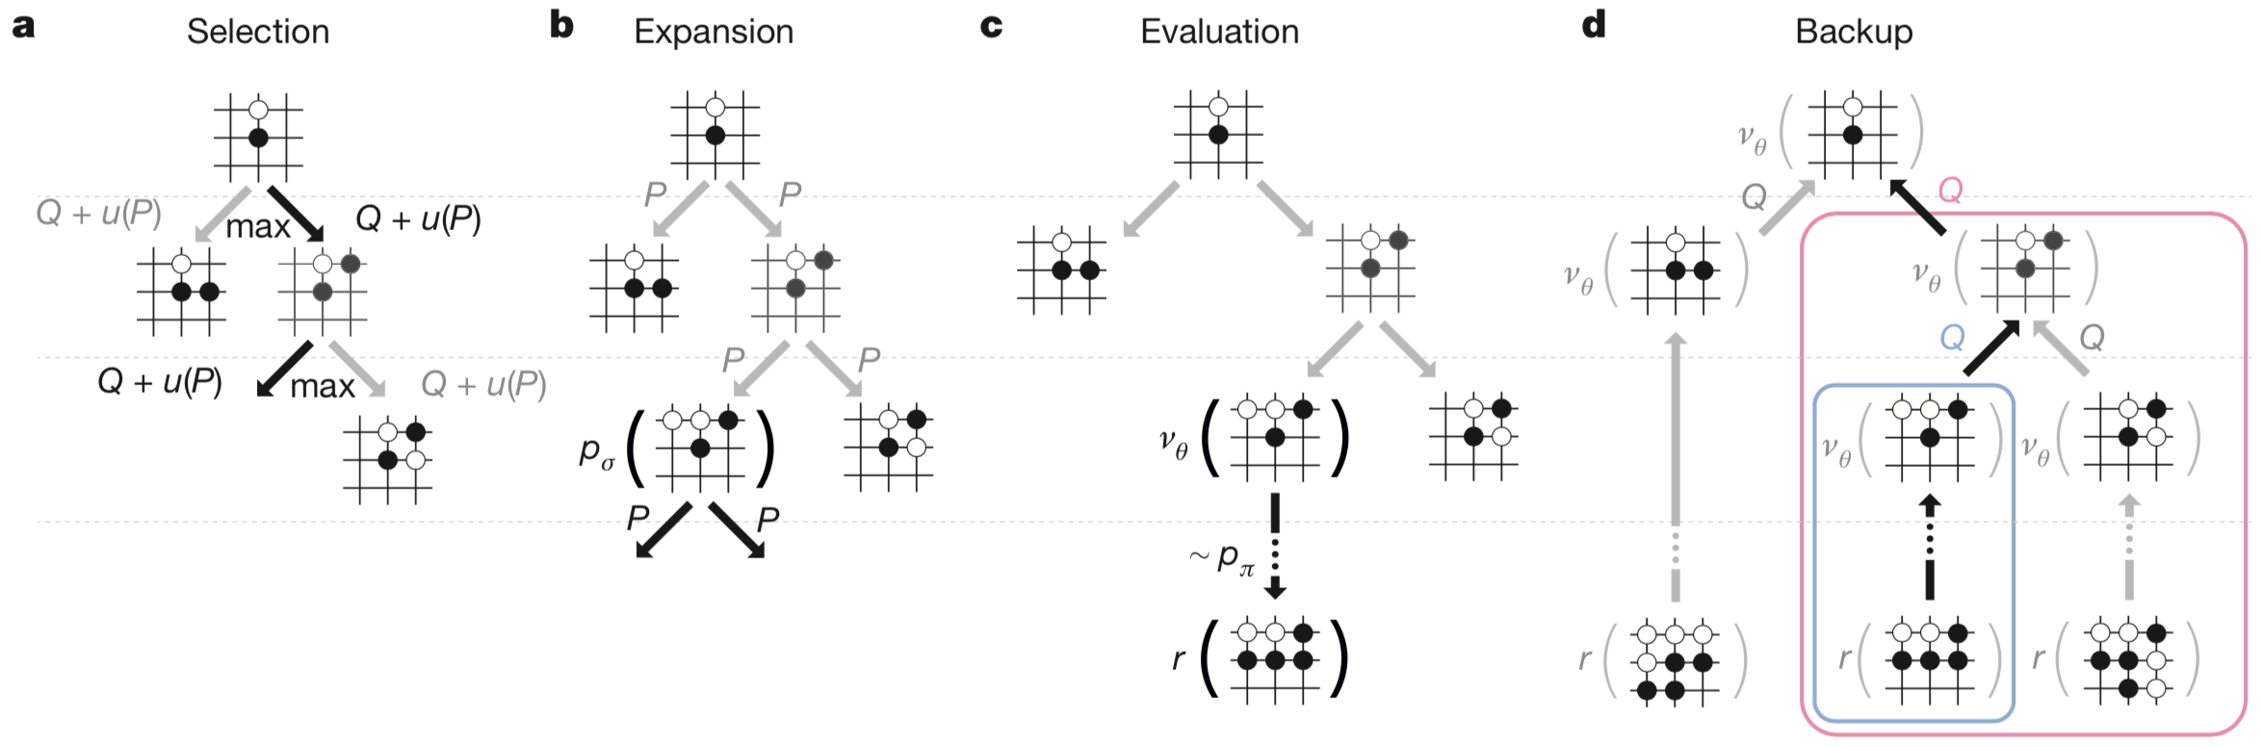
Example: Go
UT Dallas CS6301 Special Topics in Computer Science – Convolutional Neural Networks
AlphaGo
Figure from https://storage.googleapis.com/deepmind-media/alphago/AlphaGoNaturePaper.pdf

Slide 68
Example: Go
UT Dallas CS6301 Special Topics in Computer Science – Convolutional Neural Networks
AlphaGo → AlphaGo Zero
The results of AlphaGo were quite amazing
AlphaGo learned from humans to become pretty good
Improved itself via self play to become good
Then coupled it’s good play with MCTS to become the best (better than the top human)
But is it necessary to learn from humans to become super human in play? Or, is it possible for an algorithm to teach itself to play in a super human way?

Slide 69
Example: Go
UT Dallas CS6301 Special Topics in Computer Science – Convolutional Neural Networks
AlphaGo Zero
A goal of AlphaGo Zero
Remove human knowledge used in training AlphaGo
No human training games; only self play
No human heuristics in input feature maps; only white stones, black stones, history and turn info for input feature maps
Some additional key modifications relative to AlphaGo
A single network with policy and value heads
No Monte Carlo rollouts
MCTS based look ahead inside the training loop

Slide 70
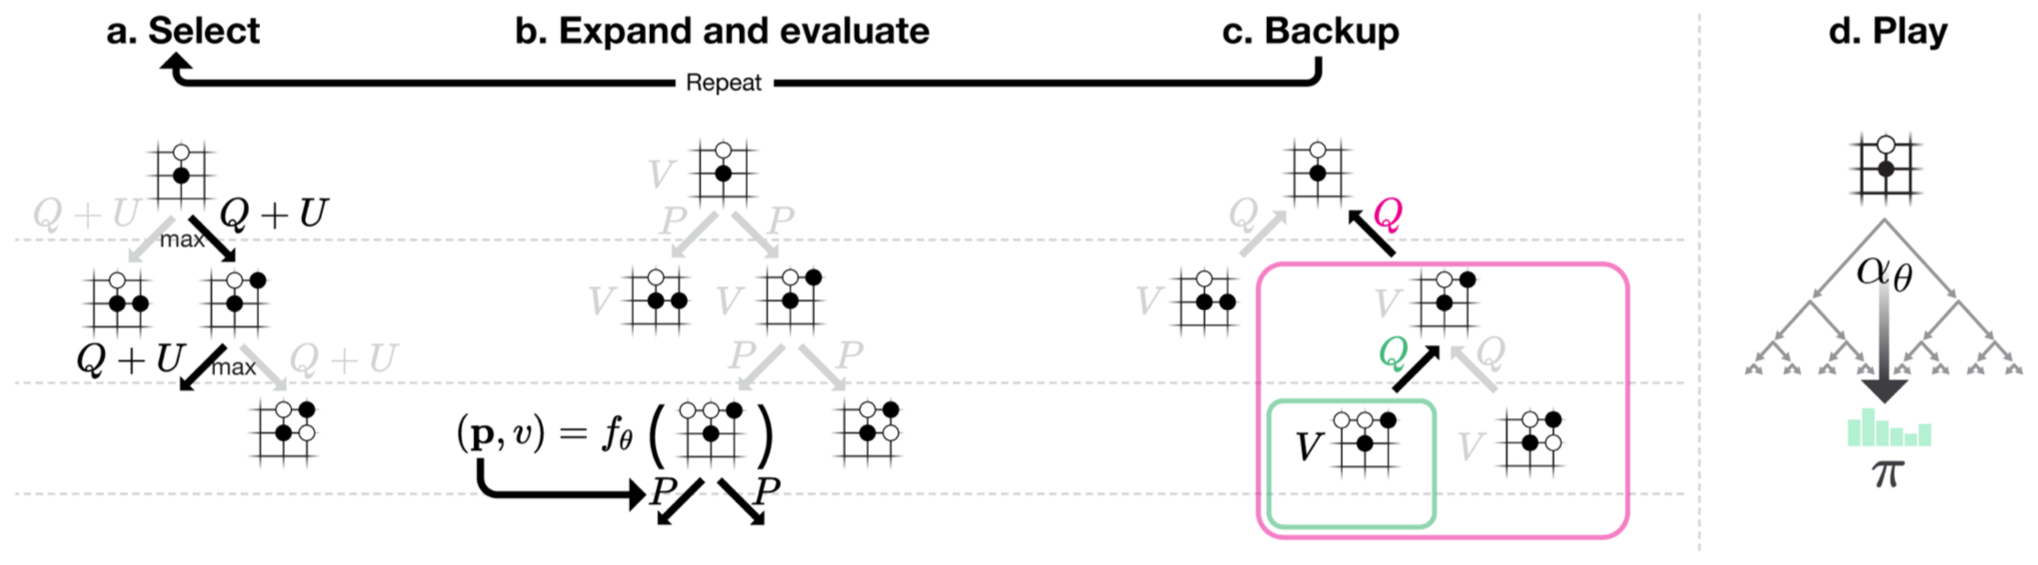
Example: Go
UT Dallas CS6301 Special Topics in Computer Science – Convolutional Neural Networks
AlphaGo Zero
Consider a xNN that takes the board state as it’s input and outputs a pmf of actions and a value of the present state: (p_{π_f} , V_{f}) = f_{Θ}(s)
f has parameters Θ and a ResNet V1 style structure with two 3x3 filters in the residual path, batch norm and ReLU
There were 2 versions of the shared portion of the network, 1 with 20 residual blocks and 1 with 40 residual blocks
The policy network has 2 additional layers: two CNN style 2D convolutions with 1x1 filters, batch norm, ReLU and a fully connected layer with 19² + 1 = 362 outputs
The value network has 3 additional layers: 1 CNN style 2D convolution with 1x1 filters, batch norm, ReLU, a fully connected layer with 256 outputs and ReLU, a fully connected layer with 1 output and a tanh nonlinearity
Training
Step 0: initialize the policy and value xNN f_{Θ}
Step 1: self play using MCTS enhanced with f_{Θ}
Step 2: xNN training to improve f_{Θ}
Repeat to Step 1
This can be thought of as a search based policy iteration
Game play via MCTS enhanced with f_{Θ}
Figure from https://deepmind.com/blog/alphago-zero-learning-scratch/

Slide 71
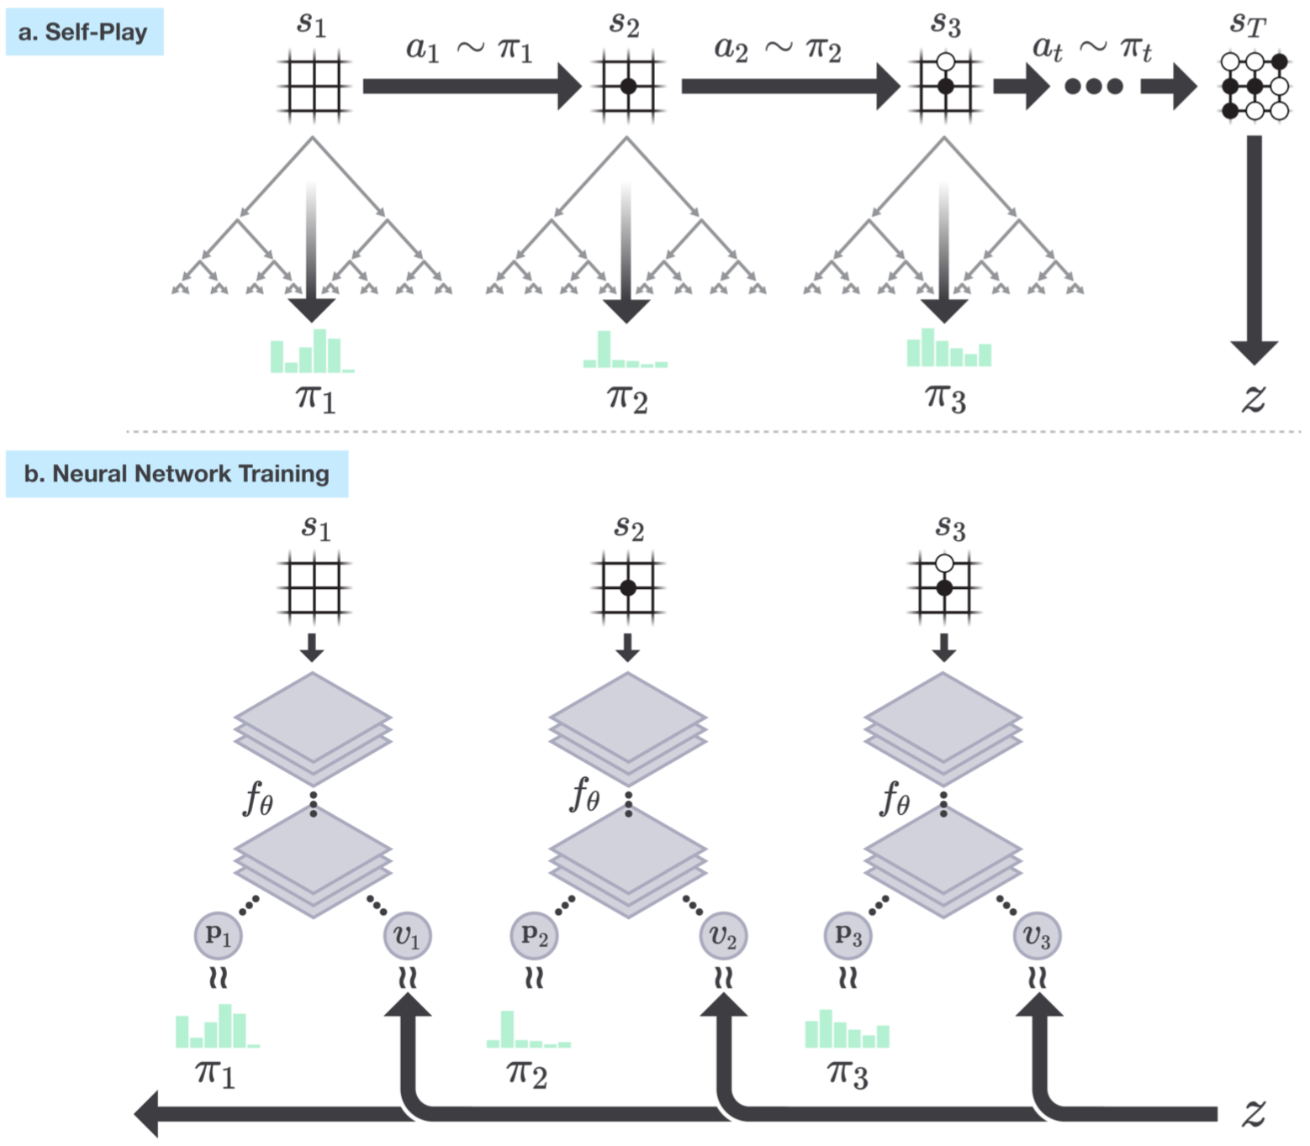
Example: Go
UT Dallas CS6301 Special Topics in Computer Science – Convolutional Neural Networks
AlphaGo Zero
Step 1: self play using MCTS enhanced with f_{Θ}
AlphaGo Zero plays a game against itself
A pmf of moves p_{π_MCTS} is created via MCTS enhanced with the latest f_{Θ}
UCT is modified to include p_{π_f} in move selection for implicit breadth reduction
V_{f} is used for leaf scoring for implicit depth reduction
p_{π_MCTS} is proportional to visit count raised to a temperature parameter
The game is scored to determine the winner V_{MCTS}
Results are stored for all of the states and moves as (s_{t}, p_{π_MCTS}, V_{MCTS}) tuples
Step 2: xNN training to improve f_{Θ}
For each board position s_{t} the xNN parameters Θ are updated to minimize a 3 part error term via SGD with momentum
Part 1: cross entropy between p_{π_f} and p_{π_MCTS}
Part 2: mean square error between V_{f} and V_{MCTS}
Part 3: scaled L₂ regularization term on the parameters Θ
MCTS is effectively creating an improved policy and value target to use to update the xNN weights
Initialize network parameters
Loop
Step 1 self play
Step 2 policy and value improvement
Figure from https://deepmind.com/blog/alphago-zero-learning-scratch/

Slide 72
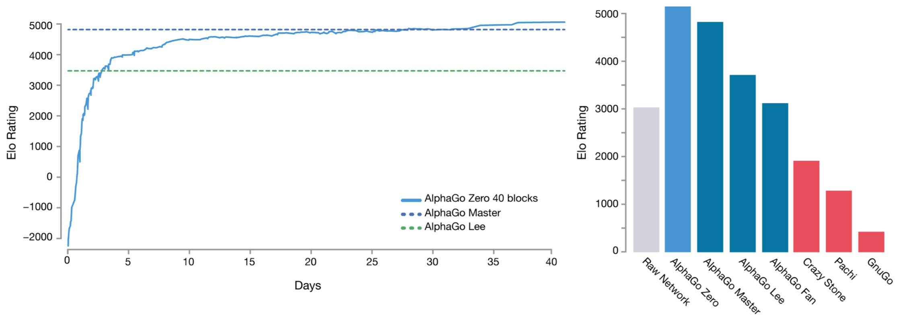
Example: Go
UT Dallas CS6301 Special Topics in Computer Science – Convolutional Neural Networks
AlphaGo Zero
Figure from https://deepmind.com/blog/alphago-zero-learning-scratch/

Slide 73
Example: Chess
UT Dallas CS6301 Special Topics in Computer Science – Convolutional Neural Networks
Alpha Zero
AlphaGo Zero used a relatively general training strategy to learn a policy for a turn based 2 player zero sum game without human knowledge
Alpha Zero makes a few additional modifications to the AlphaGo Zero training strategy then applies the same training strategy to multiple games and achieves (arguably) the best performance in each relative to all humans and other computer programs
Go
Chess
Shogi
A summary of training strategy modifications relative to AlphaGo Zero
Value target based on expected outcome vs win / loss
No exploitation of rotation and reflection invariance
Continual updates of the single neural network vs maintaining a best player

Slide 74
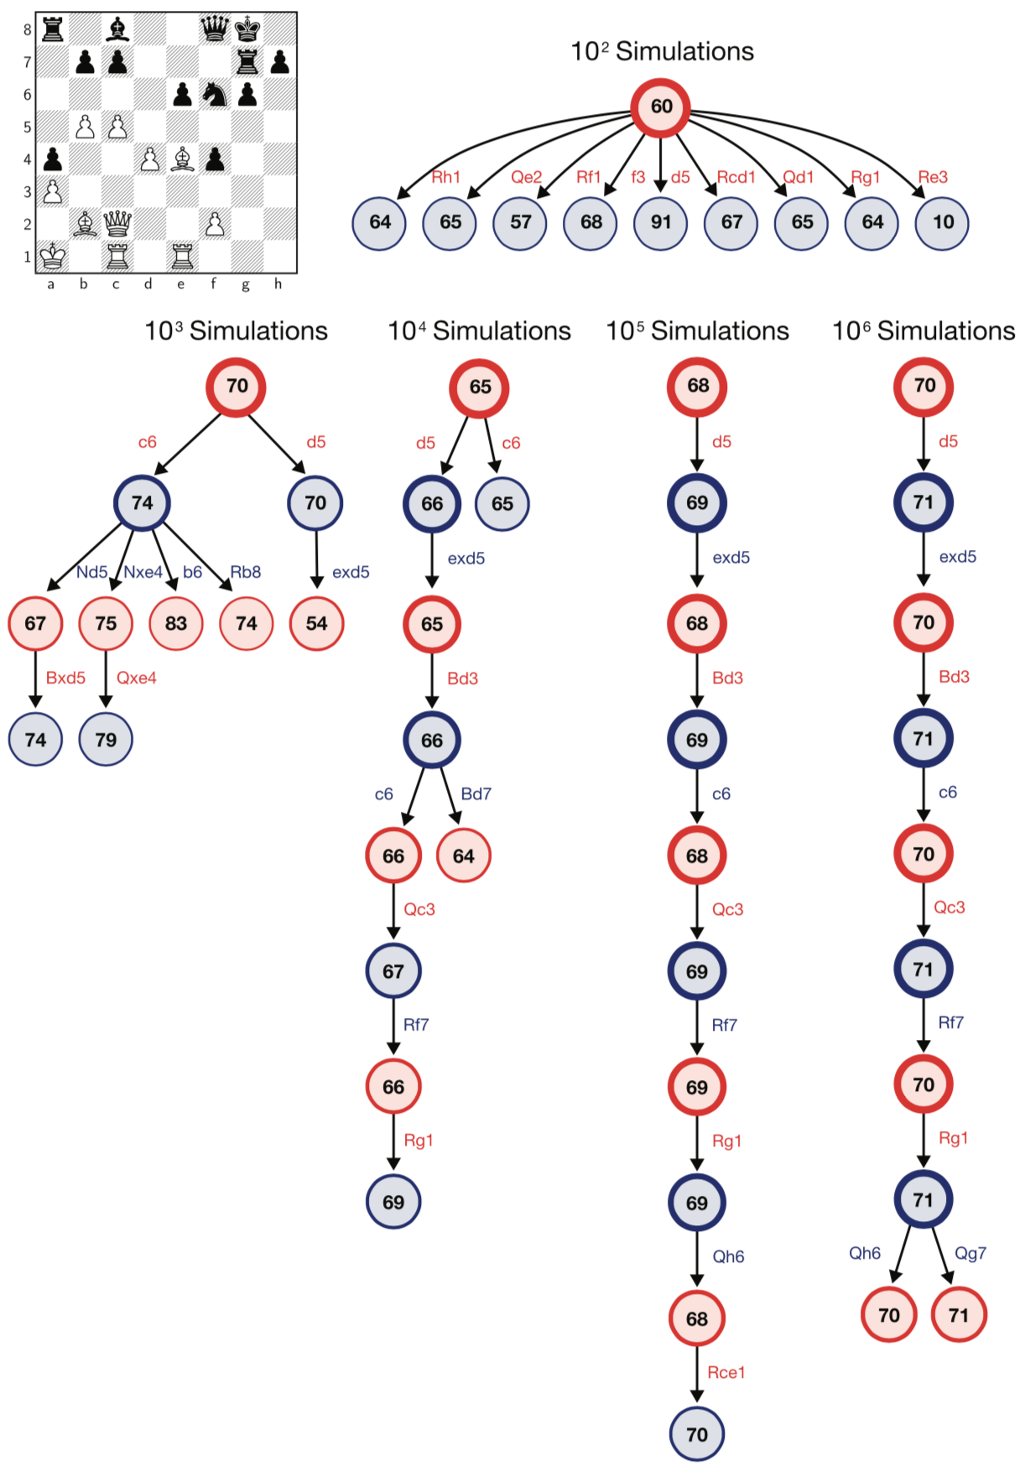
Example: Chess
UT Dallas CS6301 Special Topics in Computer Science – Convolutional Neural Networks
Alpha Zero
An example of how MCTS focuses as a function of the number of simulations
In general, Alpha Zero evaluates many fewer positions than programs like Stockfish that use Alpha Beta pruning but the positions that it evaluates are of much higher quality as a result of the policy and value network
Sort of like a super human
High quality move evaluations like a person would do
Just lots more and deeper
Figure from https://deepmind.com/research/publications/general-reinforcement-learning-algorithm-masters-chess-shogi-and-go-through-self-play/

Slide 75
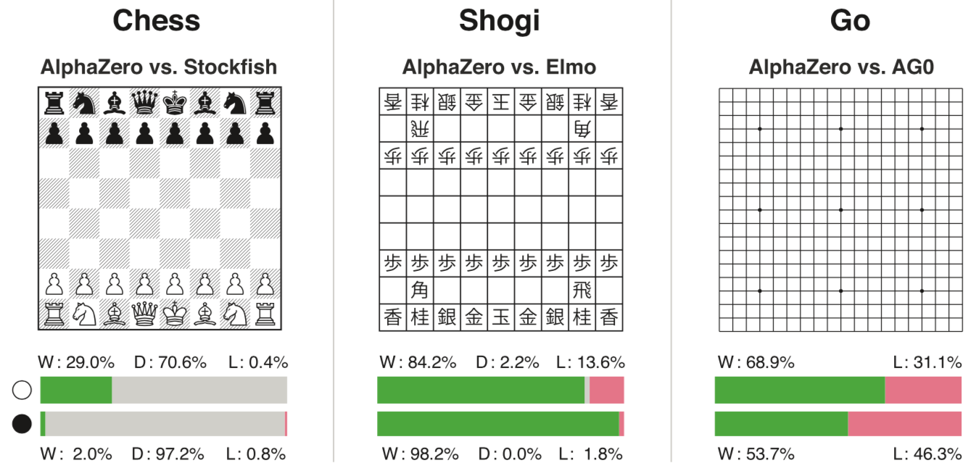
Example: Chess
UT Dallas CS6301 Special Topics in Computer Science – Convolutional Neural Networks
Alpha Zero
Figure from https://deepmind.com/research/publications/general-reinforcement-learning-algorithm-masters-chess-shogi-and-go-through-self-play/

Slide 76
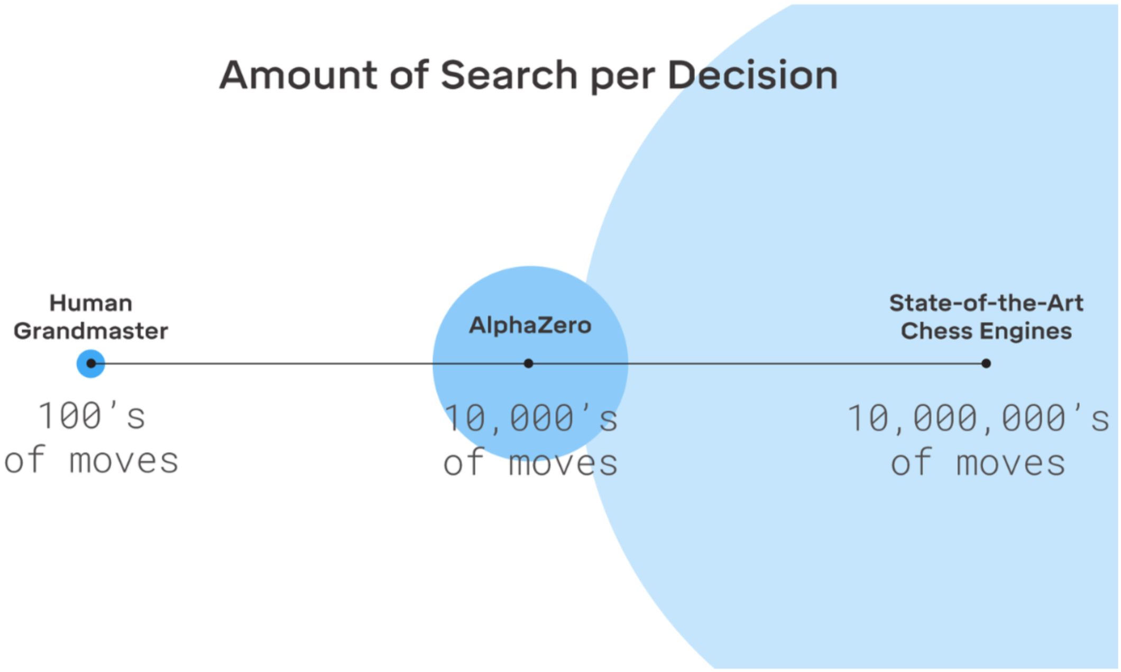
Example: Chess
UT Dallas CS6301 Special Topics in Computer Science – Convolutional Neural Networks
Alpha Zero
Figure from https://deeplearning.mit.edu

Slide 77
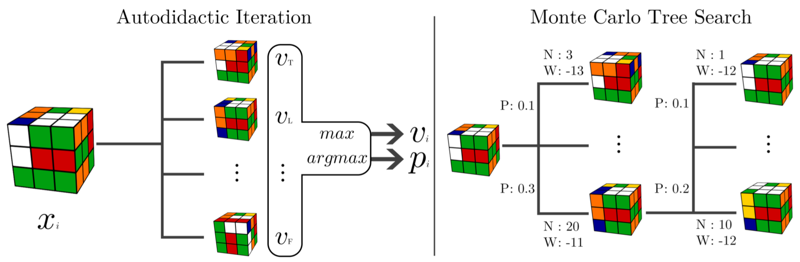
Example: Rubik’s Cube
UT Dallas CS6301 Special Topics in Computer Science – Convolutional Neural Networks
Autodidactic iteration trains a value and policy network
Start from a solved cube and an initialized network that predictions values and move pmfs
Generate training samples via 90 degree moves from the set of 12 valid moves {F, F’, B, B’, L, L’, R, R’, U, U’, D, D’} where the letter indicates the face and no prime / prime indicates the direction
For each of the training samples generate all of it’s children via making all possible moves
For each child determine the value and use the maximum value and associated move to improve the network parameters
MCTS used the trained value and policy networks to implicitly reduce breadth and depth
Figure from https://arxiv.org/abs/1805.07470

Slide 78
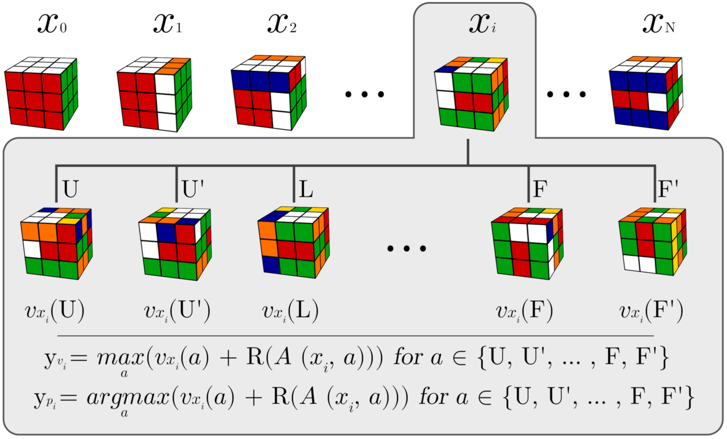
Example: Rubik’s Cube
UT Dallas CS6301 Special Topics in Computer Science – Convolutional Neural Networks
Autodidactic iteration trains a value and policy network
Start from a solved cube and an initialized network that predictions values and move pmfs
Generate training samples via 90 degree moves from the set of 12 valid moves {F, F’, B, B’, L, L’, R, R’, U, U’, D, D’} where the letter indicates the face and no prime / prime indicates the direction
For each of the training samples generate all of it’s children via making all possible moves
For each child determine the value and use the maximum value and associated move to improve the network parameters
MCTS used the trained value and policy networks to implicitly reduce breadth and depth
Figure from https://arxiv.org/abs/1805.07470

Slide 79
Appendix
UT Dallas CS6301 Special Topics in Computer Science – Convolutional Neural Networks

Slide 80
Derivation Of Policy Gradient
UT Dallas CS6301 Special Topics in Computer Science – Convolutional Neural Networks
OpenAI spinning up part 3: policy optimization
https://spinningup.openai.com/en/latest/spinningup/rl_intro3.html

Slide 81
Derivation Of EGLP Lemma
UT Dallas CS6301 Special Topics in Computer Science – Convolutional Neural Networks
OpenAI spinning up part 3: policy optimization
https://spinningup.openai.com/en/latest/spinningup/rl_intro3.html

Slide 82
References
UT Dallas CS6301 Special Topics in Computer Science – Convolutional Neural Networks

Slide 83
General
UT Dallas CS6301 Special Topics in Computer Science – Convolutional Neural Networks
Reinforcement learning: an introduction
http://incompleteideas.net/book/bookdraft2017nov5.pdf
Spinning up in deep RL
https://spinningup.openai.com/en/latest/
UC Berkeley CS 294-112 Deep reinforcement learning
http://rail.eecs.berkeley.edu/deeprlcourse/
David Silver talks
http://www0.cs.ucl.ac.uk/staff/d.silver/web/Talks.html
Deep reinforcement learning course
https://simoninithomas.github.io/Deep_reinforcement_learning_Course/
https://github.com/simoninithomas/Deep_reinforcement_learning_Course
Policy gradient algorithms
https://lilianweng.github.io/lil-log/2018/04/08/policy-gradient-algorithms.html
Deep reinforcement learning agents
https://github.com/awjuliani/DeepRL-Agents

Slide 84
Software
UT Dallas CS6301 Special Topics in Computer Science – Convolutional Neural Networks
Bullet Physics SDK
https://pypi.org/project/pybullet/
Horizon: Facebook's open source applied reinforcement learning platform
https://arxiv.org/abs/1811.00260
MuJoCo advanced physics simulation
http://www.mujoco.org
OpenAI gym
https://github.com/openai/gym

Slide 85
Software
UT Dallas CS6301 Special Topics in Computer Science – Convolutional Neural Networks
Reinforcement learning in TensorFlow with TF-Agents (TF Dev Summit ‘19)
https://www.youtube.com/watch?v=-TTziY7EmUA
TF-Agents: a library for reinforcement learning in TensorFlow
https://github.com/tensorflow/agents
https://github.com/tensorflow/agents/tree/master/tf_agents/colabs
Dopamine
https://github.com/google/dopamine
The DeepMind control suite and package
https://github.com/deepmind/dm_control
Integration of TensorFlow and Unity 3D for a basketball game
https://medium.com/tensorflow/tf-jam-shooting-hoops-with-machine-learning-7a96e1236c32

Slide 86
Value Based Methods
UT Dallas CS6301 Special Topics in Computer Science – Convolutional Neural Networks
Human-level control through deep reinforcement learning
https://www.nature.com/articles/nature14236
Deep reinforcement learning with double q-learning
https://arxiv.org/abs/1509.06461
Prioritized experience replay
https://arxiv.org/abs/1511.05952
Dueling network architectures for deep reinforcement learning
https://arxiv.org/abs/1511.06581
Value iteration networks
https://arxiv.org/abs/1602.02867
Rainbow: combining improvements in deep reinforcement learning
https://arxiv.org/abs/1710.02298

Slide 87
Value Based Methods
UT Dallas CS6301 Special Topics in Computer Science – Convolutional Neural Networks
Episodic memory deep Q-networks
https://arxiv.org/abs/1805.07603
A theoretical analysis of deep Q-learning
https://arxiv.org/abs/1901.00137
Google DeepMind's deep Q-learning playing Atari Breakout
https://www.youtube.com/watch?v=V1eYniJ0Rnk

Slide 88
Policy Based Methods
UT Dallas CS6301 Special Topics in Computer Science – Convolutional Neural Networks
Trust region policy optimization
https://arxiv.org/abs/1502.05477
High-dimensional continuous control using generalized advantage estimation
https://arxiv.org/abs/1506.02438
Learning continuous control policies by stochastic value gradients
https://arxiv.org/abs/1510.09142
Asynchronous methods for deep reinforcement learning
https://arxiv.org/abs/1602.01783
Proximal policy optimization algorithms
https://arxiv.org/abs/1707.06347
Soft actor-critic algorithms and applications
https://arxiv.org/abs/1812.05905

Slide 89
Model Based Methods
UT Dallas CS6301 Special Topics in Computer Science – Convolutional Neural Networks
Thinking fast and slow with deep learning and tree search
https://arxiv.org/abs/1705.08439
Efficient selectivity and backup operators in Monte-Carlo Tree search
https://hal.inria.fr/inria-00116992/document
Monte Carlo Tree Search – beginners guide
https://int8.io/monte-carlo-tree-search-beginners-guide/
A survey of Monte Carlo tree search methods
https://ieeexplore.ieee.org/document/6145622

Slide 90
AlphaGo
UT Dallas CS6301 Special Topics in Computer Science – Convolutional Neural Networks
Mastering the game of go with deep neural networks and tree search
https://www.nature.com/articles/nature16961
https://storage.googleapis.com/deepmind-media/alphago/AlphaGoNaturePaper.pdf
AlphaGo: using machine learning to master the ancient game of go
https://blog.google/technology/ai/alphago-machine-learning-game-go/

Slide 91
AlphaGo Zero
UT Dallas CS6301 Special Topics in Computer Science – Convolutional Neural Networks
Mastering the game of go without human knowledge
https://www.nature.com/articles/nature242702017-silver.pdf
AlphaGo Zero: learning from scratch
https://deepmind.com/blog/alphago-zero-learning-scratch/
MiniGo: TensorFlow meets Andrew Jackson (TensorFlow meets)
https://www.youtube.com/watch?v=LRqlmjL3-n8
Minigo: A minimalist go engine modeled after AlphaGo Zero, built on MuGo
https://github.com/tensorflow/minigo

Slide 92
Alpha Zero
UT Dallas CS6301 Special Topics in Computer Science – Convolutional Neural Networks
Mastering chess and shogi by self-play with a general reinforcement learning algorithm
https://arxiv.org/abs/1712.01815
A general reinforcement learning algorithm that masters chess, shogi and go through self-play
https://deepmind.com/research/publications/general-reinforcement-learning-algorithm-masters-chess-shogi-and-go-through-self-play/
AlphaZero: Shedding new light on the grand games of chess, shogi and go
https://deepmind.com/blog/alphazero-shedding-new-light-grand-games-chess-shogi-and-go/
Deepmind AlphaZero - mastering games without human knowledge
https://www.youtube.com/watch?v=Wujy7OzvdJkELF
OpenGo: an analysis and open reimplementation of AlphaZero
https://arxiv.org/abs/1902.04522
https://facebook.ai/developers/tools/elf-opengo
https://github.com/pytorch/ELF
Leela chess zero
https://lczero.org

Slide 93
Alpha Zero
UT Dallas CS6301 Special Topics in Computer Science – Convolutional Neural Networks
AlphaZero: shedding new light on the grand games of chess, shogi and Go
https://www.youtube.com/watch?v=7L2sUGcOgh0
agadmator's Chess Channel
https://www.youtube.com/user/AGADMATOR/videos
Chess24
https://www.youtube.com/user/chess24media/videos
AlphaZero's attacking chess
https://www.youtube.com/watch?v=nPexHaFL1uo

Slide 94
Rubik’s Cube
UT Dallas CS6301 Special Topics in Computer Science – Convolutional Neural Networks
Solving the Rubik's cube without human knowledge
https://arxiv.org/abs/1805.07470

Slide 95
DotA2
UT Dallas CS6301 Special Topics in Computer Science – Convolutional Neural Networks
OpenAI Five
https://blog.openai.com/openai-five/
Emergent complexity via multi-agent competition
https://arxiv.org/abs/1710.03748
The Dota 2 bot competition
https://ieeexplore.ieee.org/abstract/document/8356682
Calculating optimal jungling routes in DOTA2 using neural networks and genetic algorithms
https://computing.derby.ac.uk/ojs/index.php/gb/article/view/14
Skill-based differences in spatio-temporal team behaviour in defence of the ancients 2 (DotA 2)
https://ieeexplore.ieee.org/abstract/document/7048109

